Slide 1


ACTIVITY 1: PARTNERSHIP
Introduction
Notes:
GUIDELINES FOR ERASMUS+ NAs
Section Title Page: it can be useful to have a space to breathe between the different sections (and sub-sections) of the training.

Slide 2

Learning Outcome: ASSESS the composition and quality of partnerships, REFLECT on their relevance to the selected field, the targeted audiences and the planned actions and outputs
Notes:
GUIDELINES FOR ERASMUS+ NAs
Learning Outcome for A1-PARTNERSHIP: adapt this to reflect what you will actually deliver or address during your assessor training event.

Slide 3

Five Slides in Five Minutes
Notes:
GUIDELINES FOR ERASMUS+ NAs
This follows the concept of keeping things simple and promoting the use of active and peer learning approaches during the training session. Each of the core elements being judged under QUALITY OF PROJECT PARTNERSHIP is to be quickly introduced, highlighting key aspects but keeping the introduction short to allow for participants to go forward and work in groups.

Slide 4

Appropriate Mix of Skills, Experience and Expertise
Notes:
GUIDELINES FOR ERASMUS+ NAs
This relates to the sub-criterion for “project involves appropriate mix of participating organisations in terms of profile, past experience in the Programme and expertise to successfully complete all project objectives”. The idea is to mention that different actions can participate as long as they are relevant to the selected field and to highlight both traditional (e.g. schools, adult education centres, VET institutions, Universities) and non-traditional partner organisations (e.g. policy makers; sectoral bodies; regional or community development agencies; employers). It is important to also highlight the need for applicants to demonstrate their experience in the targeted field.

Slide 5

Newcomers
Notes:
GUIDELINES FOR ERASMUS+ NAs
This relates to the sub-criterion for “project involves newcomers and less-experienced organisations to the action”. The idea is to highlight the importance of newcomers for the programme and the targeted actions, especially in KA210 where the focus is on widening access to the Erasmus+ programme.

Slide 6

Active Contributions
Notes:
GUIDELINES FOR ERASMUS+ NAs
This relates to the sub-criterion for “proposed allocation of tasks demonstrates the commitment and active contribution of all participating organisations”. The idea is to highlight the importance of having a clear insight into the roles that the different partners will play, as well as having a clear rationale for attributing roles, tasks and responsibilities, ensuring that these are consistent with the profiles, experience and expertise of the participating partners.

Slide 7

Coordination and Communication
Notes:
GUIDELINES FOR ERASMUS+ NAs
This relates to the sub-criterion for “proposal includes effective mechanisms for coordination and communication between the participating organisations, as well as with other relevant stakeholders”. The idea is to highlight the importance of coordination and communication methods and processes, ensuring that sufficient insight is given into this important aspect of project delivery and partner engagement and that the proposed actions extend across the project lifetime and make active use of digital communications platforms technologies, where appropriate.

Slide 8

Essential Added-Value
Notes:
GUIDELINES FOR ERASMUS+ NAs
This relates to the sub-criterion for “involvement of organisation(s) from a third country not associated to the Programme brings essential added-value to the project”. The idea is to highlight the importance of having a clear insight into the added-value of third country participation, confirming both the skills and expertise that these organisations bring to the project and the essential nature of their participation in the project with a view to ensuring a higher quality of project results. It can be useful to give examples of countries included under this heading (e.g. UK, USA, Switzerland, Australia, China).

Slide 9


KA220 Assessment Criteria: Partnership
2026
Extent to which…
Project involves APPROPRIATE MIX of participating organisations in terms of profile, past experience in the Programme, and expertise to successfully complete all project objectives.
Project involves NEWCOMERS and less-experienced organisations to the action.
Proposed allocation of tasks demonstrates the commitment and ACTIVE CONTRIBUTION of all participating organisations.
Proposal includes effective mechanisms for COORDINATION and COMMUNICATION between participating organisations, and other relevant stakeholders.
Where relevant: Involvement of organisation(s) from a THIRD COUNTRY not associated to the Programme brings ESSENTIAL ADDED-VALUE to the project.
Notes:
GUIDELINES FOR ERASMUS+ NAs
This overview slide confirms those aspects which relate to KA220 (all listed elements) and those which relate to KA210 (labelled as SSP). It provides an opportunity to underline ambitions for engaging newcomers in KA210 and the need for proportional assessment.

Slide 10
ACTIVITY 1: PARTNERSHIP
Field-based Groupwork
Notes:
GUIDELINES FOR ERASMUS+ NAs
Section Title Page: it can be useful to have a space to breathe between the different sections (and sub-sections) of the training.

Slide 11
Assessment Results - Quality of Partnership ADULT EDUCATION (ADU)
Threshold: 10
Notes:
GUIDELINES FOR ERASMUS+ NAs
Scoring Example 1 (ADU): in cases where assessors are invited to undertake a mock assessment, scores should be submitted to a central contact point, in advance, to allow a simple chart or overview to be prepared in which the range or variety of scores is shown. It can be useful to position these above or below the funding threshold to show the consequence of scoring. In cases where a large number of assessors are participating in KA2 assessor training then it can be useful to divide them according to the field that they will assess and to provide a field-specific proposal for mock assessment. In cases where a small number of assessors will participate, a single field might be selected as an example for all assessors to work on.
Note: the above chart is provided only as an example with a need, in all cases, to produce your own charts that include scoring data from your own assessors.

Slide 12
Assessment Results - Quality of Partnership HIGHER EDUCATION (HED)
Threshold: 10
Notes:
GUIDELINES FOR ERASMUS+ NAs
Scoring Example 2 (HED): in cases where assessors are invited to undertake a mock assessment, scores should be submitted to a central contact point, in advance, to allow a simple chart or overview to be prepared in which the range or variety of scores is shown. It can be useful to position these above or below the funding threshold to show the consequence of scoring. In cases where a large number of assessors are participating in KA2 assessor training then it can be useful to divide them according to the field that they will assess and to provide a field-specific proposal for mock assessment. In cases where a small number of assessors will participate, a single field might be selected as an example for all assessors to work on.
Note: the above chart is provided only as an example with a need, in all cases, to produce your own charts that include scoring data from your own assessors.

Slide 13
Assessment Results - Quality of Partnership SCHOOL EDUCATION (SCH)
Threshold: 10
Notes:
GUIDELINES FOR ERASMUS+ NAs
Scoring Example 3 (SCH): in cases where assessors are invited to undertake a mock assessment, scores should be submitted to a central contact point, in advance, to allow a simple chart or overview to be prepared in which the range or variety of scores is shown. It can be useful to position these above or below the funding threshold to show the consequence of scoring. In cases where a large number of assessors are participating in KA2 assessor training then it can be useful to divide them according to the field that they will assess and to provide a field-specific proposal for mock assessment. In cases where a small number of assessors will participate, a single field might be selected as an example for all assessors to work on.
Note: the above chart is provided only as an example with a need, in all cases, to produce your own charts that include scoring data from your own assessors.

Slide 14
Assessment Results - Quality of Partnership VOCATIONAL EDUCATION AND TRAINING (VET)
Threshold: 10
Notes:
GUIDELINES FOR ERASMUS+ NAs
Scoring Example 4 (VET): in cases where assessors are invited to undertake a mock assessment, scores should be submitted to a central contact point, in advance, to allow a simple chart or overview to be prepared in which the range or variety of scores is shown. It can be useful to position these above or below the funding threshold to show the consequence of scoring. In cases where a large number of assessors are participating in KA2 assessor training then it can be useful to divide them according to the field that they will assess and to provide a field-specific proposal for mock assessment. In cases where a small number of assessors will participate, a single field might be selected as an example for all assessors to work on.
Note: the above chart is provided only as an example with a need, in all cases, to produce your own charts that include scoring data from your own assessors.

Slide 15


FIELD-BASED GROUPWORK
Appoint Rapporteur
Agree Score
Sub-divide Large Groups
Share Perspectives
Group Recap and Review
90
INCLUDING SHORT COFFEE BREAK
Notes:
GUIDELINES FOR ERASMUS+ NAs
After sharing scores in a plenary session, the next step is to encourage discussion on the proposal that was reviewed, either in field-based groups or as a whole group that has reviewed a single proposal. Depending on the number of assessors being trained, breakout rooms or spaces might be needed. In STEP 1, larger groups should be sub-divided to facilitate discussion. In STEP 2, a rapporteur should be appointed to provide feedback in plenary. In STEP 3, each assessor should share their thoughts and perspectives on the project reviewed. In STEP 4, groups should try to agree on a single score for “QUALITY OF PARTNERSHIP”. In a FINAL STEP, the rapporteur should confirm key messages and a single score within the group, to ensure that all participants are in agreement before returning to plenary.
If working in a room or space where a the group has been sub-divided, it can be useful to compare results across the different sub-groups before returning to plenary. The decision on whether or not to compare results across sub-groups will also depend on the time available, following initial discussions and scoring. In all cases, the timeclock should be updated to reflect your own schedule.

Slide 16
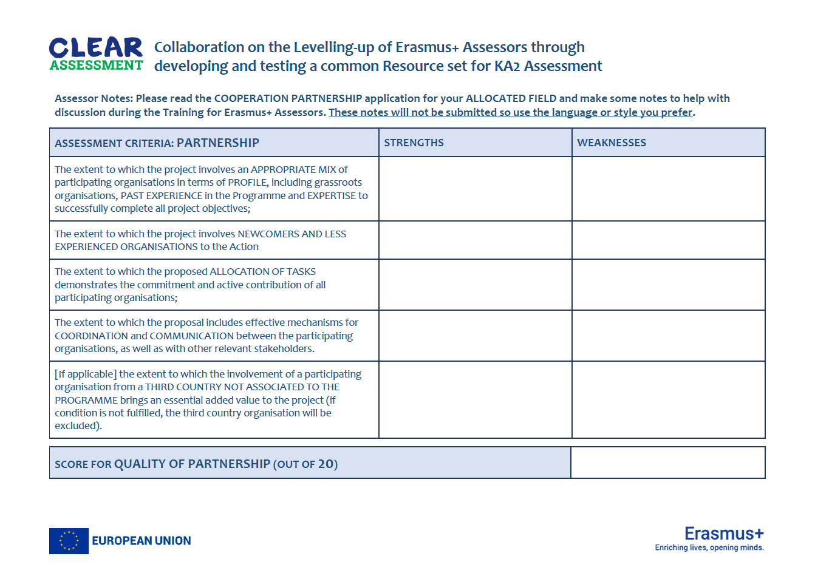
Notes:
GUIDELINES FOR ERASMUS+ NAs
As a part of the homework exercise, it can be useful to provide a template for assessors to record their thoughts. This screen shows an example of such a template. It is important, however, to confirm that this template is for the mock assessment exercise only and does not relate to the formal assessment exercise where strengths and weaknesses would come together in a single set of comments. Note: template graphic based on previous event (might need to update to latest version).

Slide 17
ACTIVITY 1: PARTNERSHIP
Plenary Exchange
Notes:
GUIDELINES FOR ERASMUS+ NAs
Section Title Page: it can be useful to have a space to breathe between the different sections (and sub-sections) of the training.

Slide 18

Plenary Exchange
1. Did you agree on a single score (as a whole group, or as two sub-groups)?
2. What method or approach did you adopt when sharing perspectives?
3. Where there any difficulties? Were some elements more complex than others?
RAPPORTEUR FEEDBACK
5
Notes:
GUIDELINES FOR ERASMUS+ NAs
This is a simple prompt for the plenary feedback session, providing a small number of questions against which the different groups (and sub-groups) will be invited to comment. Depending on the number of groups, and the time available, the time give to each rapporteur might need to be changed (usually 3 to 5 minutes per rapporteur).

Slide 19

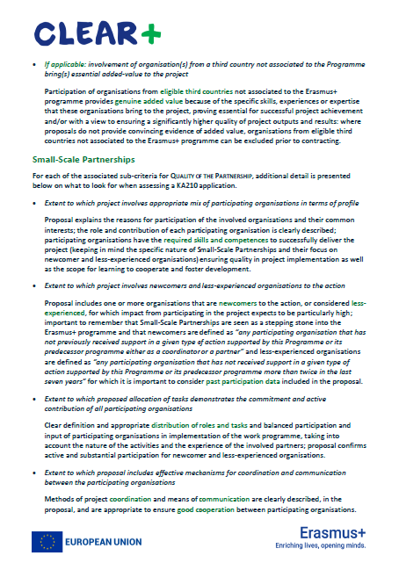
Briefing Sheet:
Quality of Partnership
Notes:
GUIDELINES FOR ERASMUS+ NAs
In this final slide, it can be useful to remind assessors of the availability of a written briefing sheet which confirms the key elements being judged under “QUALITY OF PARTNERSHIP”.

