Slide 1


ERASMUS+ KA220
Assessment Comments
Notes:
GUIDELINES FOR ERASMUS+ NAs
Section Title Page: it can be useful to have a space to breathe between the different sections of the training.

Slide 2
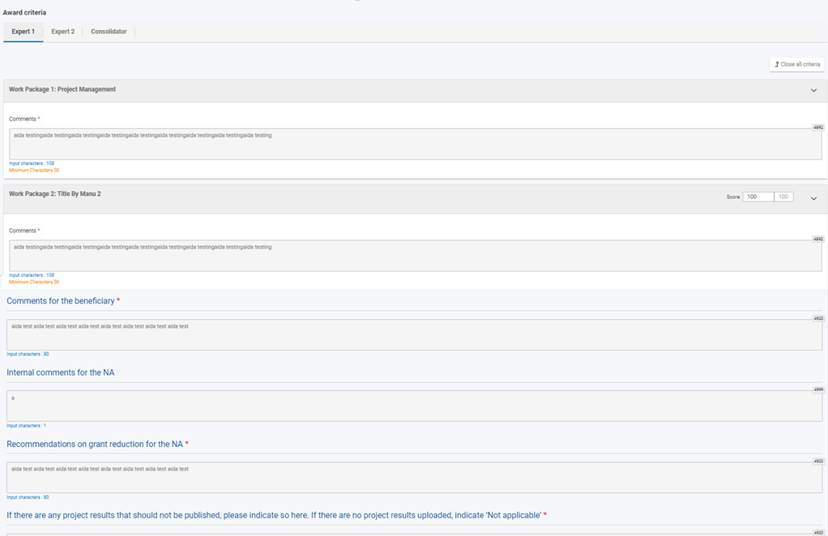
Quality Assessment: Online Assessment Module
Comments for each WP (including wp1)
Scores for each WP (excluding wp1)
important: refer to scoring bands and consequences Weighted Average is auto-calculated
Comments for the Beneficiary (overall summary)
all wps scored out of 100: not just a mathematical sum
Internal Comments for the NA
Recommendations on additional Grant Reductions
Typology questions are also asked on a separate page
REMEMBER TO SAVE YOUR WORK AND KEEP A BACK-UP
Notes:
GUIDELINES FOR ERASMUS+ NAs
This slide can be used to present a short overview of the online assessment module. If you are having a dedicated presentation of the online assessment module, then you can remove this slide. At this point, you can also mention whether an MS Word template exists and can/should be used.

Slide 3

Quality Assessment and Quality Assurance
Five Cs
Coherent comments should be easy to understand - even for someone that has not read the report - and should provide feedback that the applicant will understand and can learn from | Comprehensive comments should be provided for each of the award criteria (written text, not bullet points) and should incorporate all composite elements | Consistent comments should be consistent with scores that have been awarded for each criterion and should be aligned with the overall scoring bands for this funding action | Courteous comments should always be polite and respectful, and should avoid first person references (e.g. I think that; I suggest that) | Concise comments must be within the maxima accepted by the online evaluation tool (usually 3000 characters); experts should also avoid repeating that which is written in the final report
Notes:
GUIDELINES FOR ERASMUS+ NAs
This slide presents the model of 5*Cs, each of which should be briefly introduced. It is especially important to underline that it is the responsibility of all Erasmus+ National Agencies to quality assure the work of their assessors. This initial input forms an important baseline for this activity on comments. Note: consolidation (often referred to as the sixth C) is addressed in a separate activity.

Slide 4

ACCEPT
UNSURE
REJECT
Quality Review: What Would You Do?
Notes:
GUIDELINES FOR ERASMUS+ NAs
For this activity, participants should be told that they will play the role of a member of NA staff and that they need to decide whether the written comments align with the model of the 5*Cs and whether they choose to ACCEPT or REJECT the written comments. This can be done by standing or raising hands when a specific category is
called out (e.g. all those who ACCEPT this please raise their hand) or, more effectively, by raising a red or green card. An orange card can also be used by assessors that are unsure (or by raising both red and green cards together, to indicate an orange vote). Alternatively, digital platforms can be used to replicate this activity, where assessors are asked to vote according to what they see on the screen.

Slide 5

Phone, Tablet or PC
A Few Minutes to Log In
ONE Vote per Question
Notes:
GUIDELINES FOR ERASMUS+ NAs
This is a slide which informs participants that a digital voting tool will be used. Adapt as needed.

Slide 6
Assessment Comments for WP1: Accept or Reject
ACCEPT
UNSURE
REJECT
The project involved partners from four EU and associated third countries, with the beneficiary taking the lead in coordination, cooperation and communication actions. Management actions were threefold and centred on use of a digital platform for day-to-day partner exchanges, as well as hosting virtual meetings (20) and face-to-face meetings (4). Erasmus+ online platforms were used during planning, preparation and delivery of the project and involved mainly the lead beneficiary partner. Potential risks were identified at the project outset, alongside relevant mitigation strategies. Partners report 100% satisfaction with WP1 and project management delivery.
Notes:
GUIDELINES FOR ERASMUS+ NAs
Ask participants to vote using your chosen method (e.g. raise hands, show cards, vote digitally). Invite 1 or 2 participants to justify their decision before sharing your own perspective. This comment would normally be REJECTED for the following reason: there are lots of statements, but no real qualitative assessment or opinion is provided.

Slide 7
Assessment Comments for WP1: Accept or Reject
ACCEPT
UNSURE
REJECT
Partner engagement was sufficient. Management actions were adequate. Erasmus+ online platforms were effectively used. Risk management was appropriate. Reported satisfaction levels (100%) are substantiated.
Notes:
GUIDELINES FOR ERASMUS+ NAs
Ask participants to vote using your chosen method (e.g. raise hands, show cards, vote digitally). Invite 1 or 2 participants to justify their decision before sharing your own perspective. This comment would normally be REJECTED for the following reason: some qualitative assessment is provided but there is a general lack of supporting detail: not a lot of detail is required, but some substantiation is needed.

Slide 8
Assessment Comments for WP1: Accept or Reject
ACCEPT
UNSURE
REJECT
Partner engagement was active across the lifetime of the project, with exceptional absences which were fully justified. Management and coordination efforts are clearly detailed and pertinent, relying on a digital communication platform and regular (virtual and face-to-face) partner meetings for reviews of progress, planning and co-development. Sufficient evidence is provided of the different tools and activities. Erasmus+ online digital platforms were used effectively at key stages in the project lifetime, including EPALE and the EPRP. Early-stage risk analysis informed regular discussions among partners on schedules, progression and emerging risks, with valid strategies employed for preventing, managing and mitigating risks. An overall satisfaction level of 100% is reported and is substantiated by a clear and credible overview of management-related events and activities, across the two-year project lifetime, adequately detailing the role of lead and support actors.
Notes:
GUIDELINES FOR ERASMUS+ NAs
Ask participants to vote using your chosen method (e.g. raise hands, show cards, vote digitally). Invite 1 or 2 participants to justify their decision before sharing your own perspective. This comment would normally be ACCEPTED for the following reason: comments are clear, comprehensive, easy to comprehend, courteous and related specifically to the proposal - without unnecessarily repeating the original text of the proposal; comments provide the necessary qualitative opinion and judgement.

Slide 9
Assessment Comments for WP1: Accept or Reject
ACCEPT
UNSURE
REJECT
Partners are reported to have been actively engaged but this is not credible as they are involved in so many European projects and partnerships that they probably only came to the partner meetings. Management actions are meetings and little else. A digital platform is not a management tool but a place to chat!! Erasmus+ digital platforms were apparently used but I looked on EPALE and I cannot find anything. The link that they provided is to a two-line comment in a post by somebody else. This is just lazy! The biggest risk was to give money to this partnership. We should definitely ask for a full refund, as management efforts are very poor. Not what I would deliver. It is unbelievable that they report 100% satisfaction. Are they satisfied with themselves? I would probably award just 10%, or even 0% if it is possible.
Notes:
GUIDELINES FOR ERASMUS+ NAs
Ask participants to vote using your chosen method (e.g. raise hands, show cards, vote digitally). Invite 1 or 2 participants to justify their decision before sharing your own perspective. This comment would normally be REJECTED for the following reason: judgements are personal (first person should be avoided in written comments) and not in all cases courteous or polite. Provocative statements such as “this is just lazy!” are not helpful and should be avoided.

Slide 10
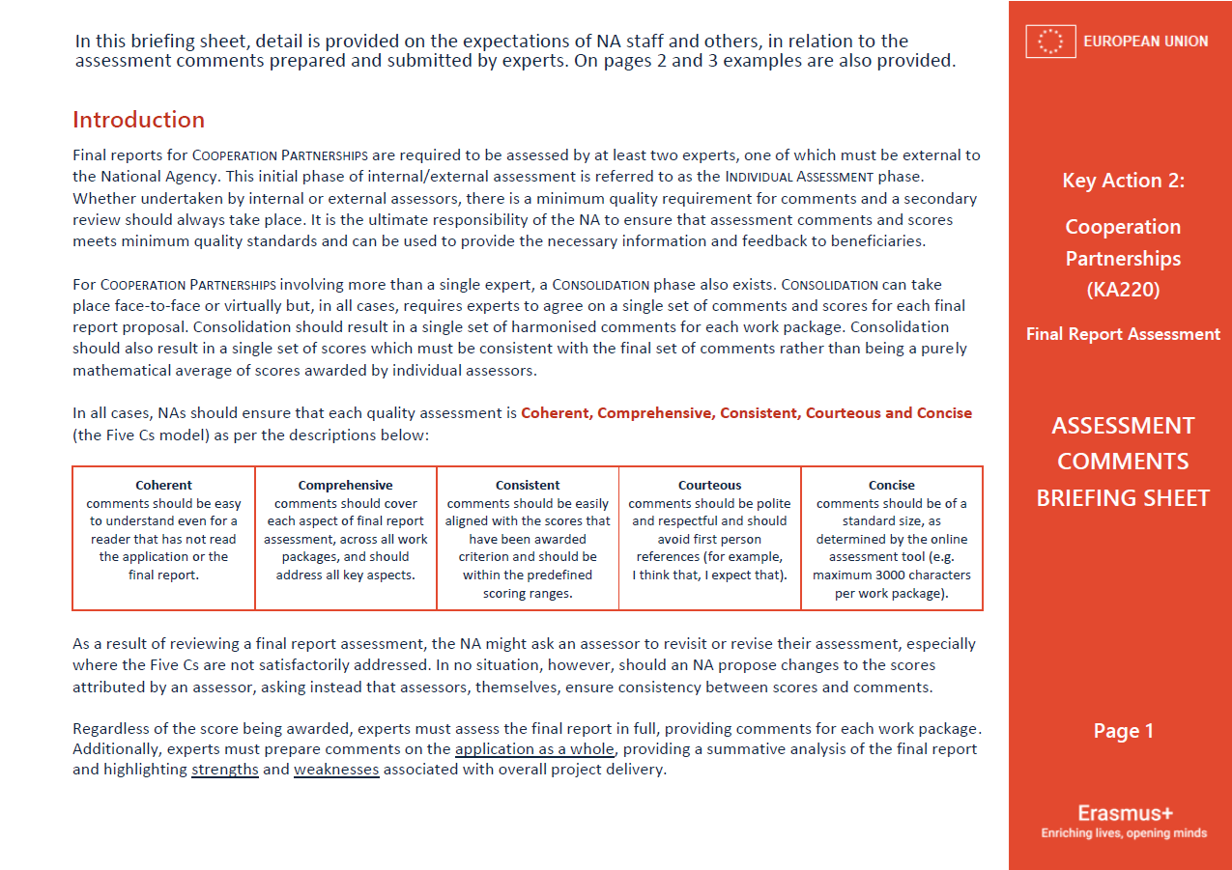
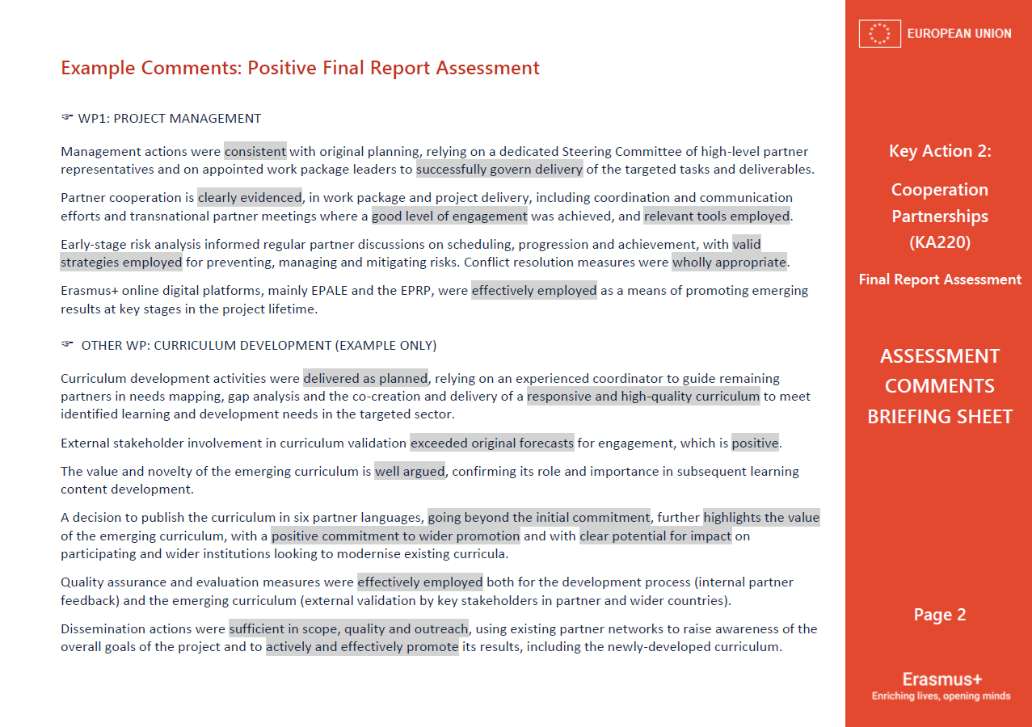
Assessment Comments Briefing Sheet
Notes:
GUIDELINES FOR ERASMUS+ NAs
This final slide can be useful to remind assessors of the availability of a written briefing sheet on ASSESSMENT COMMENTS for individuals delivering final report assessments for KA220 projects (2022 onwards).

