Slide 1
ERASMUS+ KA210
Assessment Comments
Notes:
GUIDELINES FOR ERASMUS+ NAs
Section Title Page: it can be useful to have a space to breathe between the different sections of the training.

Slide 2
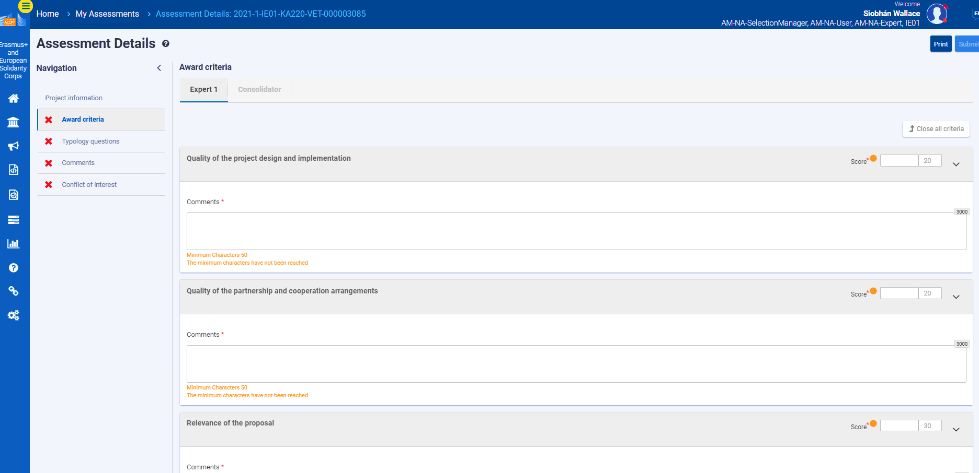
Quality Assessment: Online Assessment Module
Comments for each Assessment Criterion
scores for each assessment criterion (refer to scoring bands and thresholds) Total calculated automatically.
Comments for the Applicant (overall summary)
Remember that different maxima exist for different assessment criteria
Internal Comments for the NA
Typology questions are also asked on a separate page
REMEMBER TO SAVE YOUR WORK AND KEEP A BACK-UP
Notes:
GUIDELINES FOR ERASMUS+ NAs
This slide can be used to present a short overview of the online assessment module. If you are having a dedicated presentation of the online assessment module, then you can remove this slide. At this point, you can also mention whether an MS Word template exists and can/should be used.

Slide 3
Quality Assessment and Quality Assurance
Five Cs
Coherent comments should be easy to understand - even for someone that has not read the report - and should provide feedback that the applicant will understand and can learn from | Comprehensive comments should be provided for each of the award criteria (written text, not bullet points) and should incorporate all composite elements | Consistent comments should be consistent with scores that have been awarded for each criterion and should be aligned with the overall scoring bands for this funding action | Courteous comments should always be polite and respectful, and should avoid first person references (e.g. I think that; I suggest that) | Concise comments must be within the maxima accepted by the online evaluation tool (usually 3000 characters); experts should also avoid repeating that which is written in the final report
Notes:
GUIDELINES FOR ERASMUS+ NAs
This slide presents the model of 5*Cs, each of which should be briefly introduced. It is especially important to underline that it is the responsibility of all Erasmus+ National Agencies to quality assure the work of their assessors. This initial input forms an important baseline for this activity on comments. The concept of consolidation can also be discussed (the sixth C) if this is a process that you use in your NA.

Slide 4
ACCEPT
UNSURE
REJECT
What Would You Do?
Notes:
GUIDELINES FOR ERASMUS+ NAs
For this activity, participants should be told that they will play the role of a member of NA staff and that they need to decide whether the written comments align with the model of the 5*Cs and whether they choose to ACCEPT or REJECT the written comments. This can be done by standing or raising hands when a specific category is
called out (e.g. all those who ACCEPT this please raise their hand) or, more effectively, by raising a red or green card. An orange card can also be used by assessors that are unsure. This can also be done by raising RED and GREEN cards at the same time (i.e. red and green = orange).

Slide 5
Three Volunteers Needed
Notes:
GUIDELINES FOR ERASMUS+ NAs
This is a slide which reminds participants that volunteers will be needed. If you are opting for an all-participant voting process, instead, then this slide can be removed.

Slide 6
Short Examples of Assessment Comments : Accept or Reject
ACCEPT
UNSURE
REJECT
The final report confirms a good mix of partners that represent the selected field of VET, with partners positively extending to both education and industry. The selected priorities are correct for the year of financing (2022) and it is good to see inclusion and diversity selected as a priority for this project. The benefits of cross-border collaboration are clear and credible, when looking at all that is planned.
Notes:
GUIDELINES FOR ERASMUS+ NAs
Ask participants to vote using your chosen method (e.g. raise hands, show cards). Invite 1 or 2 participants to justify their decision before sharing your own perspective. This comment would normally be REJECTED for the following reason: there are lots of statements, but no real qualitative assessment or opinion is provided.

Slide 7
Assessment Comments for Relevance: Accept or Reject
ACCEPT
UNSURE
REJECT
Project delivery is consistent with original planning and with the selected Erasmus+ priorities, including inclusion and diversity which is convincingly addressed through the actions and outputs that have been delivered. The value of cross-border collaboration is clear, with clear efforts to build capacity within the coordinating institution, through a programme of physical and virtual exchanges with a more experienced partner from Spain. All planned actions were delivered as planned, within only minimal changes to the schedule for event delivery. The overall methodology and approach is consistent with original planning, with no reported changes to the number of events, levels of staff engagement, budgetary provisions or final outputs. Evaluation measures are clearly defined and consistent with the size and scale of the project. Impact is clear for participating staff, and the applicant institution as a whole. Valid efforts have been made to promote overall achievement with credible plans for continued marketing and promotion.
Notes:
GUIDELINES FOR ERASMUS+ NAs
Ask participants to vote using your chosen method (e.g. raise hands, show cards). Invite 1 or 2 participants to justify their decision before sharing your own perspective. This comment would normally be ACCEPTED for the following reason: comments are clear, comprehensive, easy to comprehend, courteous and related specifically to the proposal - without unnecessarily repeating the original text of the proposal; comments provide the necessary qualitative opinion and judgement.

Slide 8
Assessment Comments for Relevance: Accept or Reject
ACCEPT
UNSURE
REJECT
I do not understand why this project was financed. They are definitely not newcomers as they have received lots of EU funding from other projects and programmes. Inclusion and diversity has been selected as a means of getting additional points. They do not plan anything innovative… all that they talk about has been done many times before! The planned actions were delivered but I do not see how they can deliver change and improvement in policy and practice through hosting a few meetings and events. The partners are already well-known to each other so there is no real novelty or value in the planned cross-border transnational collaboration. How does Europe benefit from this?
Notes:
GUIDELINES FOR ERASMUS+ NAs
Ask participants to vote using your chosen method (e.g. raise hands, show cards). Invite 1 or 2 participants to justify their decision before sharing your own perspective. This comment would normally be REJECTED for the following reason: judgements are personal (first person should be avoided in written comments) and not in all cases courteous or polite. Provocative statements such as “definitely not newcomers” are not helpful and should be avoided.

Slide 9
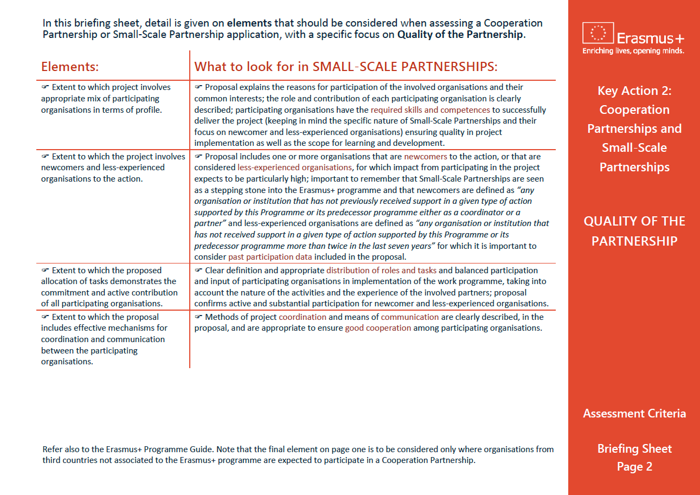
KA210 FR Assessment Briefing Sheet (expected later in 2023)
Notes:
GUIDELINES FOR ERASMUS+ NAs
This final slide can be useful to remind assessors of the availability of a written briefing sheet on ASSESSMENT COMMENTS: initially prepared for assessors involved in the assessment of KA210-KA220 funding applications, this resource is equally useful for those involved in final report assessment.

