Slide 1
ERASMUS+ KA210
What, When and Why to Assess
Notes:
GUIDELINES FOR ERASMUS+ NAs
Section Title Page: it can be useful to have a space to breathe between the different sections (and sub-sections) of the training.

Slide 2
Notes:
GUIDELINES FOR ERASMUS+ NAs
Useful graphical overview of the aspects that we consider for RELEVANCE at the point of reviewing a KA210 funding application.

Slide 3
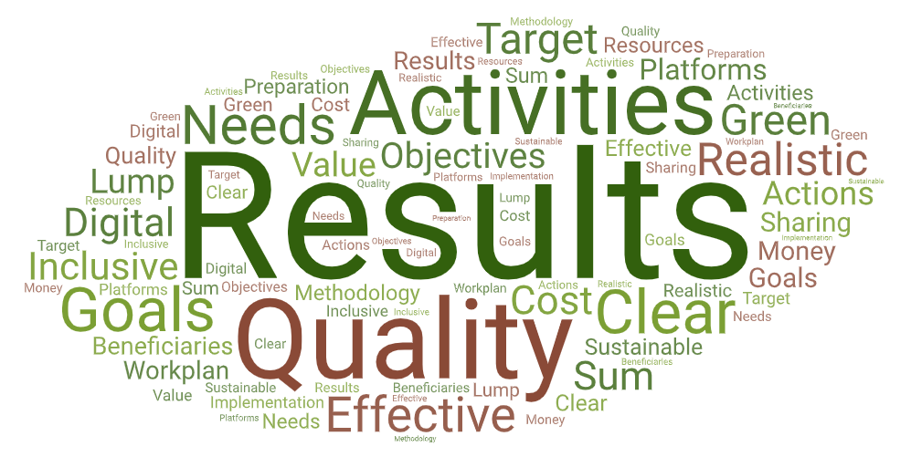
Notes:
GUIDELINES FOR ERASMUS+ NAs
Useful graphical overview of the aspects that we consider for QUALITY OF PROJECT DESIGN at the point of reviewing a KA210 funding application.

Slide 4
Notes:
GUIDELINES FOR ERASMUS+ NAs
Useful graphical overview of the aspects that we consider for QUALITY OF PARTNERSHIP at the point of reviewing a KA210 funding application.

Slide 5
Notes:
GUIDELINES FOR ERASMUS+ NAs
Useful graphical overview of the aspects that we consider for IMPACT at the point of reviewing a KA210 funding application.

Slide 6
Lump Sum Handbook: KA210 FR Assessment
Not everything that is assessed in the project proposal is judged at the project end. Mid-term review is limited, mostly adopting a model of 80-20 financing for KA210.
RELEVANCE: how the project has effectively addressed the objectives and priorities of the action and proven to build capacity to engage in transnational cooperation bringing added value at both national and EU level.
QUALITY OF PROJECT IMPLEMENTATION: quality and results achieved with activities carried out in the project.
QUALITY OF PARTNERSHIP: quality of cooperation among partners during implementation of the project.
IMPACT: integration of project results into the work of participating organisations and transferability to other stakeholders and sectors.
Notes:
GUIDELINES FOR ERASMUS+ NAs
Quick overview of what is written in the Erasmus+ Lump Sum Handbook relating to KA210 final report assessment. A useful starting point for wider discussion on what we need to review at the project end.

Slide 7
Lump Sum Handbook: KA210 FR Assessment
In addition, at the project end:
beneficiaries are invited to carry out a self-assessment exercise and to reflect on the quality of project implementation, including successes, problems and lessons learned: not clearly addressed in final report form;
project results and outcomes must be uploaded on the Erasmus+ Project Results Platform as proof of the quality of the project: distinctly mentioned at the end of the final report form but often just a project weblink;
proof of expenses is not required at the final report stage: yet beneficiaries must keep all relevant documentation to demonstrate that activities have been carried out - in case of subsequent NA checks.
Notes:
GUIDELINES FOR ERASMUS+ NAs
Continued overview of what is written in the Lump Sum Handbook relating to KA210 final report assessment. A useful starting point for wider discussion on what we need to review at the project end.

Slide 8
Beneficiary Agreement: Annex 2 - Article 6.4
The final report and project results will be assessed by the NA, using a common set of quality criteria focusing on:
extent to which the project was implemented in line with the approved grant application;
quality of activities undertaken and consistency with project objectives;
quality of the products and results produced;
learning outcomes and impact on participants;
extent to which the project proved to be innovative/complementary to other initiatives;
extent to which the project proved to add value at EU level;
extent to which the project implemented effective quality measures as well as measures for evaluating the project's outcomes;
impact on participating organisations;
quality and scope of dissemination activities undertaken;
potential wider impact of the project on individuals and organisations beyond the beneficiaries.
Notes:
GUIDELINES FOR ERASMUS+ NAs
Quick overview of what is written in the Beneficiary Agreement relating to KA210 final report assessment. This is a useful starting point for wider discussion on what we need to review at the project end.

Slide 9
Online Assessment Tool (EESC)
Criteria | Quality Assessment Score
Relevance | [out of 20 points]
Quality of Project Implementation | [out of 30 points]
Quality of Partnership | [out of 20 points]
Impact | [out of 30 points]
FINAL SCORE | [out of 100 points]
Notes:
GUIDELINES FOR ERASMUS+ NAs
Tabular overview of what the Online Assessment Tool (EESC) requires in terms of comments and scores for a KA210 final Report Assessment. It should be noted that the Online Assessment Tool does not include sub-criteria, relying mainly of the titles of the four assessment criteria plus boxes for scores.

Slide 10
FIELD-BASED GROUPWORK
Discuss ALL Sub-Criteria
Work in Field-based Groups and Select Rapporteur
Use Traffic Light System
Agree Single Colour Set for Review in Plenary
90
Notes:
GUIDELINES FOR ERASMUS+ NAs
After confirming the purpose and focus of final report assessment in a plenary session, assessors are invited to work in groups to discuss the different assessment criteria and sub-criteria, with each group invited to use a TRAFFIC LIGHT SYSTEM to confirm whether a sub-criterion is considered Green, Orange or Red. Green sub-criteria should include those which are definitely important to review again at the project end. Orange sub-criteria are those which are important to review either partially or in cases where there is a specific reference in the initial funding application (e.g. confirmed ambitions for engaging persons with fewer opportunities, for digital transformation and/or for addressing climate change and sustainable development through one or more targeted actions). Red sub-criteria are those which are judged solely at the point of application, and which do not need to be re-assessed at the project end. In STEP 1, groups should be formed, and rapporteurs appointed. Field-based groups can help to focus discussions, but mixed-field groups are also valid. In STEPS 2 and 3, all sub-criteria should be discussed and a single colour applied to each one, using the template for ACTIVITY 1. Feedback can be provided in plenary, sharing wider perspectives, or can be discussed within smaller groups if there are sufficient moderators.

Slide 11
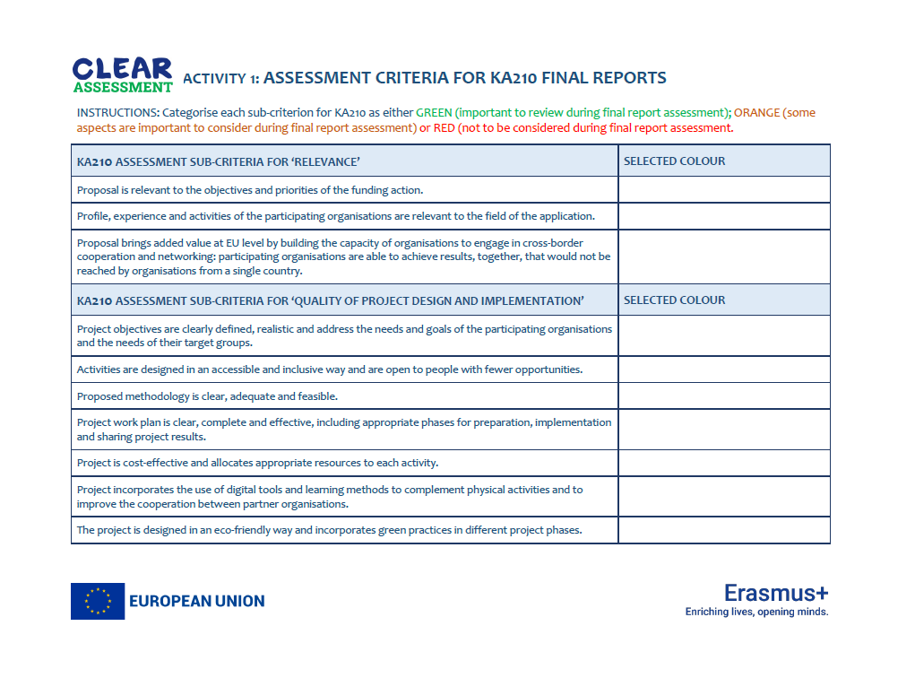
Notes:
GUIDELINES FOR ERASMUS+ NAs
This slide shows the first page of the template that is to be used for ACTIVITY 1.

Slide 12
Plenary Review
1. Task Completed? Rapporteur Selected?
2. Did any group arrive at GREEN for every single assessment sub-criterion?
3. Honest Broker Method: hold card up to show what COLOUR you selected.
RAPPORTEUR FEEDBACK plus PG THOUGHTS
Notes:
GUIDELINES FOR ERASMUS+ NAs
This slide can be used as a prompt when undertaking a plenary review of ACTIVITY 1. It is important to confirm that all sub-criteria were reviewed and to see if any group considered that all sub-criteria should be GREEN and therefore re-assessed at the project end: this is obviously not the case with some sub-criteria also considered ORANGE and RED.

Slide 13
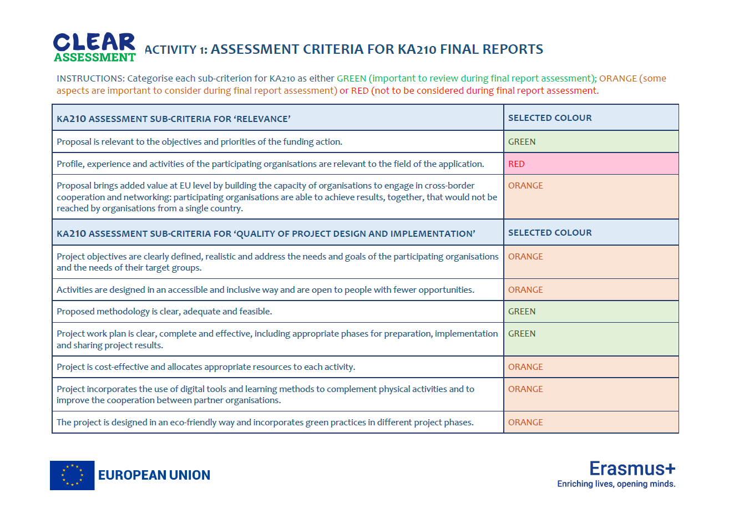
Notes:
GUIDELINES FOR ERASMUS+ NAs
This slide provides an overview of a completed template for ACTIVITY 1 [page one] and categorises individual sub-criteria as Red, Orange or Green. Additional detail on the rationale behind these decisions is provided within the KA201 Briefing Sheet.

Slide 14
Notes:
GUIDELINES FOR ERASMUS+ NAs
This slide provides an overview of a completed template for ACTIVITY 1 [page two] and categorises individual sub-criteria as Red, Orange or Green. Additional detail on the rationale behind these decisions is provided within the KA201 Briefing Sheet.

