Slide 1


ACTIVITY 4: IMPACT
Introduction
Notes:
GUIDELINES FOR ERASMUS+ NAs
Section Title Page: it can be useful to have a space to breathe between the different sections (and sub-sections) of the training.

Slide 2

Learning Outcomes:
EVALUATE impact potential, DISTINGUISH between quantitative and qualitative indicators and DELIVER an informed opinion on the adequacy and sufficiency of indicators/measures/targets
EVALUATE the validity of measures within KA210 and KA220 proposals, aimed at promotion and continued use of the developed concepts, products and services
Notes:
GUIDELINES FOR ERASMUS+ NAs
Learning Outcomes for A4-IMPACT: adapt these to reflect what you will actually deliver or address during your assessor training event.
Assessors should be alerted, at this stage, to the fact that they can choose to work on groups working either on indicators or on the sharing, promotion and use of results. Feedback from both group types will be share in plenary.

Slide 3

Six Slides in Six Minutes
Notes:
GUIDELINES FOR ERASMUS+ NAs
This follows the concept of keeping things simple and promoting the use of active and peer learning approaches during the training session. Each of the core elements being judged under IMPACT is addressed but the focus for the IMPACT activity is slightly different in that some aspects feature in multiple slides and that separate slide sets have been produced to focus on IMPACT AND INDICATORS and SHARING, PROMOTION AND USE of the end project results. In all cases, the idea is to highlight key aspects whilst keeping the introduction short to allow for participants to go forward and work in groups.

Slide 4

Four Eyes: IIII
Integration of results | Individual impact
Impact on wider audiences | Institutional impact
Notes:
GUIDELINES FOR ERASMUS+ NAs
This relates to first three sub-criteria centred on [a] “proposal includes concrete and logical steps to integrate the project results in the regular work of participating organisations”, [b] “project has the potential to positively impact on participants and participating organisations, as well as their wider communities” and [c] “project results have the potential to be used outside the organisations participating in the project, during and after the project lifetime, and at local, regional, national or European level”.
This is an active slide (multiple clicks required) that introduces the different elements of expected impact, namely: INTEGRATION OF RESULTS, INDIVIDUAL IMPACT, INSTITUTIONAL IMPACT and IMPACT ON WIDER AUDIENCES. This slide should be used to briefly introduce each of these four elements aspects and to confirm expectations for impact and the transfer of results for use by wider audiences.

Slide 5

Impact Measures
OFTEN CONFUSED WITH KEY PERFORMANCE INDICATORS
Notes:
GUIDELINES FOR ERASMUS+ NAs
This slide continues the discussion on impact-related sub-criteria, specifically element [b] “project has the potential to positively impact on participants and participating organisations, as well as their wider communities”. The idea of this slide is to underline the importance of timely activities as well as the use of targets and indicators as a means of measuring impact. It is also an opportunity to discuss the difference between performance indicators (which are normally embedded in the workplan and judged under Quality of Project Design) and Outcome and Impact Indicators.

Slide 6

Glossary of Terms (1/2)
Performance: tasks or activities carried out during the project lifetime. Example: design/develop/test digital training modules.
Outputs: product, service or deliverable that emerges from the activities carried out during the project lifetime. Example: new digital modules.
Outcomes: added-value that emerges from the activities carried out or which relates to the delivery of a specific output or deliverable. Example: improved knowledge on a particular topic; increased digital resources.
Impact: an observed change in systems, practices or behaviours - normally via longer-term observation or reflection. Example: improved learner interest and engagement; improved responsiveness to labour market needs.
Notes:
GUIDELINES FOR ERASMUS+ NAs
This slide (1 of 2) continues the discussion on impact-related sub-criteria, specifically element [b] “project has the potential to positively impact on participants and participating organisations, as well as their wider communities”. The idea of this slide is to introduce a common glossary of terms which can help assessors to understand key aspects of impact measurement, with examples also provided. Definitions and examples can be updated, to meet participant needs and expectations.

Slide 7
Glossary of Terms (2/2)
Indicator: a sign or signal that shows (or indicates) that something is true; marker of achievement; a measurable factor or value used to assess the level of achievement of an objective and/or quality of results:
- QUANTITATIVE INDICATOR: measurable; can be mathematically verified. Example: number of meetings held; number of teachers engaged; number of web downloads.
- QUALITATIVE INDICATOR: judgements or perceptions based on specific insights, interactions or experiences; can also be made quantitative but not always the case. Example: increased understanding among teachers; improved learner satisfaction.
Milestone: an important stage in the delivery of an action; an indicator of full or partial completion of a task/step. Example: user group established.
Notes:
GUIDELINES FOR ERASMUS+ NAs
This slide (2 of 2) continues the discussion on impact-related sub-criteria, specifically element [b] “project has the potential to positively impact on participants and participating organisations, as well as their wider communities”. The idea of this slide is to introduce a common glossary of terms which can help assessors to understand key aspects of impact measurement, with examples also provided. Definitions and examples can be updated, to meet participant needs and expectations.

Slide 8

Recognisable Growth
Notes:
GUIDELINES FOR ERASMUS+ NAs
This slide continues the discussion on impact-related sub-criteria, specifically element [b] “project has the potential to positively impact on participants and participating organisations, as well as their wider communities”. The idea of this slide is to underline the importance of recognising growth and of the value of baseline data in being able to determine this (e.g. pre and post assessments involving key beneficiary audiences).

Slide 9

Direct and Indirect Beneficiaries
Notes:
GUIDELINES FOR ERASMUS+ NAs
This slide continues the discussion on impact-related sub-criteria, specifically element [b] “project has the potential to positively impact on participants and participating organisations, as well as their wider communities”. The idea of this slide is to underline the importance of having a clear insight in the proposal into direct beneficiaries (primary targets) and others that will potentially benefit from the targeted actions and outputs (secondary or ultimate targets).

Slide 10
Five More Slides on SPU
Notes:
GUIDELINES FOR ERASMUS+ NAs
This follows the concept of keeping things simple and promoting the use of active and peer learning approaches during the training session. This is an additional set of slides which fits under the broader heading of IMPACT but which focuses specifically on Sharing, Promotion and Use (SPU) of the end project results.

Slide 11

Internal Audiences
Notes:
GUIDELINES FOR ERASMUS+ NAs
This relates to the sub-criterion for “proposal includes concrete and effective steps to make results known within the participating organisations, to share the results with other organisations and the public, and to publicly acknowledge EU funding”. The idea of this slide is to underline the importance of internal promotion, which is especially important for larger partner organisations, where multiple teams or departments exist. In all cases, the proposal should be clear about who is being targeted, the tools and methods that will be employed for this purpose and the timing of the proposed activities.

Slide 12

External Audiences
(multi-level)
Notes:
GUIDELINES FOR ERASMUS+ NAs
This relates to the sub-criterion for “proposal includes concrete and effective steps to make results known within the participating organisations, to share the results with other organisations and the public, and to publicly acknowledge EU funding”. The idea of this slide is to underline the importance of external promotion, which can take place at one or more levels (e.g. community-based, local, regional, national, sectoral, European, international). In all cases, the proposal should be clear about who is being targeted, the tools and methods that will be employed for this purpose and the timing of the proposed activities.

Slide 13

Digital Continuity
Notes:
GUIDELINES FOR ERASMUS+ NAs
This relates to the sub-criterion for “proposal includes concrete and effective steps to ensure the sustainability of the project; its capacity to continue having an impact and producing results after the EU grant has been used up”. The idea of this slide is to underline the importance of digital continuity, ensuring that the project has fully considered the need for open access to the end project results and that issues such as accessibility, interoperability and adaptability have been sufficiently considered in plans for future access and use.

Slide 14

Product
End Date
Notes:
GUIDELINES FOR ERASMUS+ NAs
This relates to the sub-criterion for “proposal includes concrete and effective steps to ensure the sustainability of the project; its capacity to continue having an impact and producing results after the EU grant has been used up”. The idea of this slide is to underline the importance of knowing when a product or resource might need to be reviewed, updated or removed from public access due to content being outdated. This aspect should normally be considered as a part of any high-quality legacy or sustainability planning.

Slide 15

Concrete Steps
Promotion
Multiplication
Sustainability
Notes:
GUIDELINES FOR ERASMUS+ NAs
This relates to the sub-criteria for [a] “proposal includes concrete and effective steps to ensure the sustainability of the project; its capacity to continue having an impact and producing results after the EU grant has been used up” and [b] “proposal includes concrete and effective steps to ensure the sustainability of the project; its capacity to continue having an impact and producing results after the EU grant has been used up”.
The idea of this slide is to underline the importance of having concrete and logical steps presented in the proposal, in relation to plans for short and longer-term promotion, goals for mainstreaming and transfer, and efforts to maintain and sustain the end project results beyond the initial funding period.

Slide 16


KA220 Assessment Criteria: Impact
Extent to which…
Proposal includes concrete and logical steps to INTEGRATE the project results in the regular work of participating organisations.
Project has potential to POSITIVELY IMPACT on participants and participating organisations, as well as their wider communities.
Project results have the potential to be USED OUTSIDE participating organisations, during and after the project lifetime, and at local, regional, national or European level.
Proposal includes concrete and effective steps to MAKE RESULTS KNOWN within the participating organisations, to SHARE THE RESULTS with other organisations and the public, and to publicly ACKNOWLEDGE EU FUNDING plus open access is confirmed.
Proposal includes concrete and effective steps to ensure SUSTAINABILITY of the project; its capacity to continue having an impact and producing results after the EU grant has been used up.
Notes:
GUIDELINES FOR ERASMUS+ NAs
This overview slide confirms those aspects which relate to KA220 (all listed elements) and those which relate to KA210 (labelled as SSP). It provides an opportunity to underline ambitions for engaging newcomers in KA210 and the need for proportional assessment.

Slide 17
ACTIVITY 4: IMPACT
Mixed-field Groupwork
Notes:
GUIDELINES FOR ERASMUS+ NAs
Section Title Page: it can be useful to have a space to breathe between the different sections (and sub-sections) of the training.

Slide 18

Mixed-field
Thematic Groups
Notes:
GUIDELINES FOR ERASMUS+ NAs
Unlike some of the previous activities where field-based working was encouraged, there is value in having participants work in multi-field groups where they can share experiences during the groupwork.
There are lots of options for dividing participants into groups but the simplest method is to decide how many groups you would like and, starting at the front of the room, ask participants to call out numbers in order up to the agreed number of groups. For example, if you need 5 groups, ask participants to call out 1 then 2 then 3 then 4 then 5 (in that order) before starting the count again at 1. Numbers are called out, from 1 to 5, until all participants have a number. This number determines that group that they are in for this session.

Slide 19


MIXED-FIELD GROUPWORK
Appoint Rapporteur/s
SPU Groups: Develop
SPU Strategy
Sub-divide
Large Groups
Impact Groups: Develop Impact Targets and Indicators
Recap and Consolidation
90
INCLUDING SHORT COFFEE BREAK
Notes:
GUIDELINES FOR ERASMUS+ NAs
After the plenary introduction, the next step is for participants to work either in a group that is addressing IMPACT AND INDICATORS (developing impact targets and indicators for the activities produced in activity 3: participants should be encouraged to save their templates from activity 3 to assist with activity 4) or a group that is addressing SHARING, PROMOTION AND USE of the end project results (developing a modern SP strategy).
STEP 1 allows for larger groups to be sub-divided to facilitate discussion. STEP 2 requires that a rapporteur be appointed for feedback in plenary. STEPS 3 and 4 require collaborative groupwork on the selected topic (note: it is important to have a predefined mechanism for participants to select the topic that interests them most). STEP 5 provides an opportunity for recap and review prior to feedback in plenary. The decision on whether or not to compare results across sub-groups will depend on the time available. In all cases, the timeclock should be updated to reflect your own schedule.

Slide 20
ACTIVITY 4: IMPACT
Plenary
Exchange
Notes:
GUIDELINES FOR ERASMUS+ NAs
Section Title Page: it can be useful to have a space to breathe between the different sections (and sub-sections) of the training.

Slide 21

Plenary Exchange 4a
1. How easy was it to develop indicators, targets and measures: did all assessors have the same level of insight and understanding?
2. Please can you provide examples of agreed QUANTITATIVE and QUALITATIVE INDICATORS.
3. How well do you think this is
understood by KA2-CP applicants?
RAPPORTEUR FEEDBACK
3
Notes:
GUIDELINES FOR ERASMUS+ NAs
This is a simple prompt for the first part of the plenary feedback session focusing on IMPACT AND INDICATORS, providing a small number of questions against which the different groups (and sub-groups) will be invited to comment. Depending on the number of groups, and the time available, the time given to each rapporteur might need to be changed (usually 3 to 5 minutes per rapporteur).

Slide 22
Plenary Exchange 4b
1. What are the TOP THREE elements of a modern SPU strategy?
2. Do you think that expectations are changing as we move into the digital world? Are there some areas where digital is not always best?
3. How well do you think that SPU actions
are addressed by KA2-CP applicants?
RAPPORTEUR FEEDBACK
3
Notes:
GUIDELINES FOR ERASMUS+ NAs
This is a simple prompt for the second part of the plenary feedback session focusing on SHARING, PROMOTION AND USE of the end project results, providing a small number of questions against which the different groups (and sub-groups) will be invited to comment. Depending on the number of groups, and the time available, the time given to each rapporteur might need to be changed (usually 3 to 5 minutes per rapporteur).

Slide 23
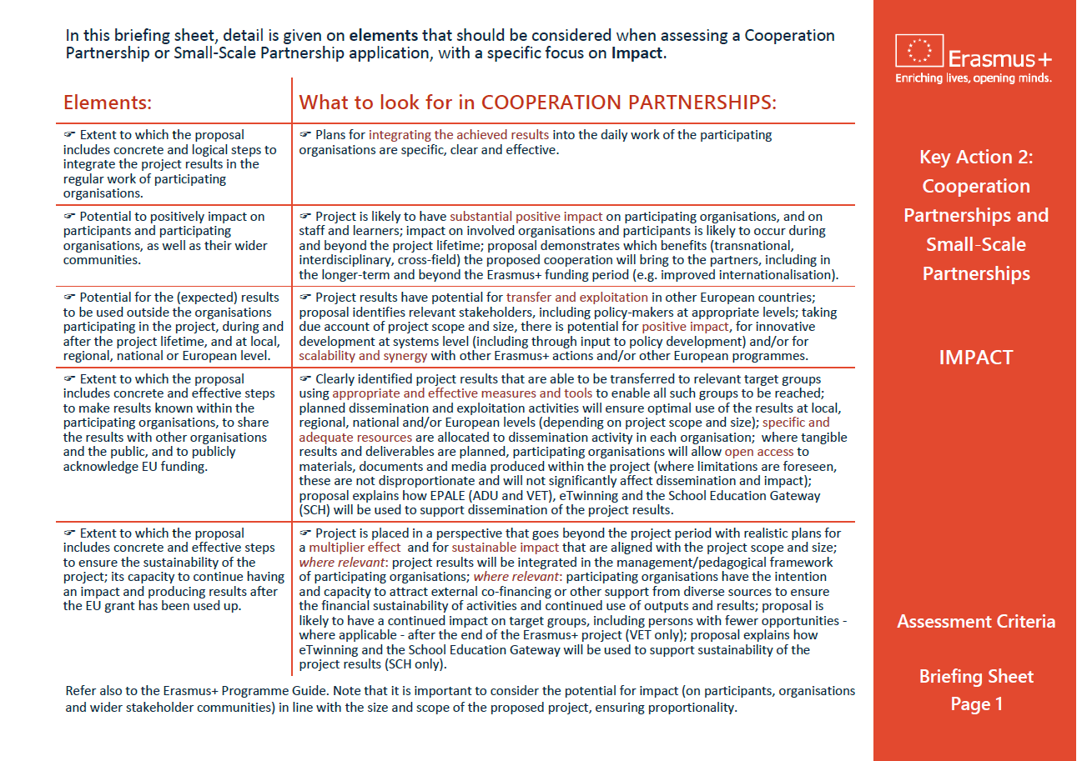
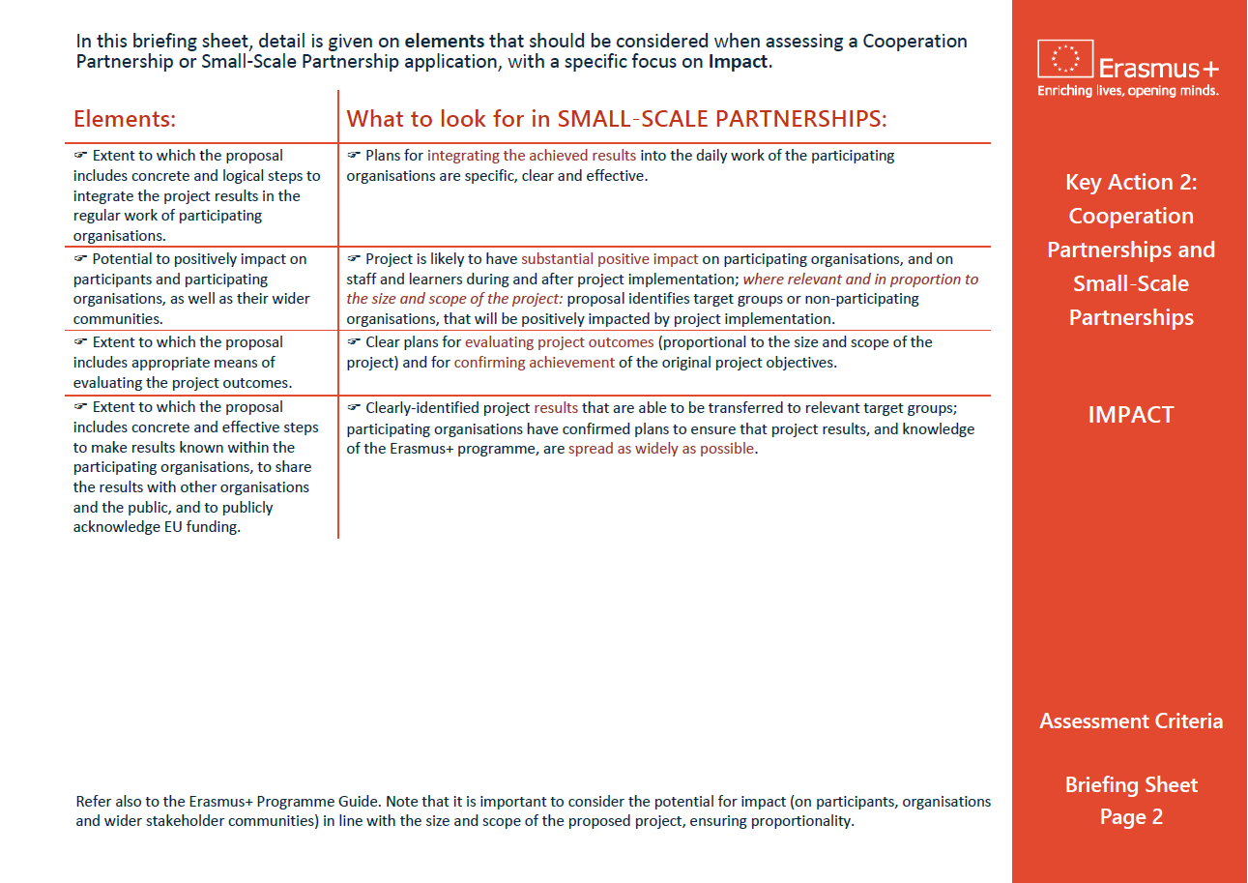
Impact Briefing Sheet
Notes:
GUIDELINES FOR ERASMUS+ NAs
In this final slide, it can be useful to remind assessors of the availability of a written briefing sheet which confirms the key elements being judged under “IMPACT”.

