Slide 1


ACTIVITY 2: RELEVANCE
Introduction
Notes:
GUIDELINES FOR ERASMUS+ NAs
Section Title Page: it can be useful to have a space to breathe between the different sections (and sub-sections) of the training.

Slide 2

Learning Outcome:
DEMONSTRATE improved understanding of the key factors involved in determining the relevance of a KA220 (or KA210) funding proposal and APPLY this in your future assessments
Notes:
GUIDELINES FOR ERASMUS+ NAs
Learning Outcome for A2-RELEVANCE: adapt this to reflect what you will actually deliver or address during your assessor training event.

Slide 3

Seven Slides in Seven Minutes
Notes:
GUIDELINES FOR ERASMUS+ NAs
This follows the concept of keeping things simple and promoting the use of active and peer learning approaches during the training session. Each of the core elements being judged under RELEVANCE is to be quickly introduced, highlighting key aspects but keeping the introduction short to allow for participants to go forward and work in groups.

Slide 4

Many policies and priorities (international, European, regional,
national, institutional, sectoral and societal) but proposals must
be relevant to Erasmus+ and the selected action.
Notes:
GUIDELINES FOR ERASMUS+ NAs
This relates to the sub-criterion for “proposal is relevant to the objectives and priorities of the funding action”. The idea is to acknowledge that other priorities exist at local, national and European levels but to remind assessors that the initial focus should be on whether or not the proposal is relevant to the objectives of the selected funding action (KA220 or KA210). It is also important for assessors to confirm that the proposal convincingly addresses at least one horizontal or sector-specific priority: where this is not the case, the proposal should be rated as Weak. In cases where a horizontal priority is selected, the proposal should additionally confirm relevance to the selected field. Where addressing the horizontal priority for inclusion and diversity, or one or more European Priorities in the National Context (as pre-announced by the National Agency), the proposal should be considered as highly relevant.

Slide 5

Everyday Activities
Notes:
GUIDELINES FOR ERASMUS+ NAs
This relates to the sub-criterion for “profile, experience and activities of the participating organisations are relevant to the field of application.”. For this slide, it is important to acknowledge that we are moving slightly into the realm of QUALITY OF PARTNERSHIP but with a specific focus on the RELEVANCE of the listed partners to the selected field. In all cases, assessors need to look for evidence that the participating organisations have experience in the targeted field, or that experience from other fields will bring benefit to the project and the selected field - this goes beyond formal or nominal relevance and should be evident in the everyday activities of partner organisations and the expertise of their staff, especially within those actions not associated to the Erasmus+ programme.

Slide 6

Needs Analysis
The proposal proves that a solid analysis, drawing on existing knowledge, know-how and practice, has been carried out to identify needs of the target group(s) and organisations.
Notes:
GUIDELINES FOR ERASMUS+ NAs
This relates to the sub-criterion for “proposal is based on a genuine and adequate needs analysis”. Here it can be useful to highlight that assessors often have different opinions on what represents a solid or convincing needs analysis, and that this is sometimes related to the field of operation for the proposal (e.g. higher expectations in some fields) and for the assessor (e.g. expectations aligned with assessor’s own insights and experience).. In all cases, assessors must be convinced that some form of needs analysis has been carried out - drawing on existing knowledge, know-how and practice – and with a view to identifying the needs of specific (and named) target and beneficiary audiences. The nature, type and extent of past needs analysis activities should be described and it should be clear how the identified needs relate to the selected field and priorities. It is also important to underline that continuing consultation, mapping and analysis actions can also take place during the lifetime of a project, as long as the initial needs analysis is adequate and convincing and as long as needs analysis does not form the majority of the targeted actions.

Slide 7

Synergies
Notes:
GUIDELINES FOR ERASMUS+ NAs
This relates to the sub-criterion for “proposal is suitable for creating synergies between different fields of education/training/youth/sport or has potentially a strong impact on one or more of these fields”. Under this slide, it is important to underline that synergies are a positive thing and should be acknowledged and rewarded but that a project that has a focus on a single field should not be penalized due to a lack of synergy with other fields.

Slide 8

The project is likely to produce results that will be innovative for its FIELD IN GENERAL, or for the GEOGRAPHICAL CONTEXT in which the project is implemented. The innovative dimension of a project can relate to the CONTENT OF THE OUTPUTS produced by the project, and/or to the PROCESSES AND WORKING METHODS applied, and/or to the ORGANISATIONS AND PERSONS INVOLVED or targeted.
Situational Innovation
Notes:
GUIDELINES FOR ERASMUS+ NAs
This relates to the sub-criterion for “proposal is innovative”. Looking beyond the formal definition provided on the screen, it is important to highlight that innovation in Erasmus+ can be situational and can be as simple as offering or facilitating the development of knowledge and skills to new audiences. In all cases, innovation should be considered in relation to the experience, profile and existing capacities of the participating organisations and their targeted audiences, the latter especially important in the case of inclusion projects involving persons with fewer opportunities.

Slide 9

Forward Progression
Notes:
GUIDELINES FOR ERASMUS+ NAs
This relates to the sub-criterion for “proposal is complementary to other initiatives already carried out by the participating organisations”. Here it is important to acknowledge that past projects are useful but to highlight the importance of knowing how past successes and achievements will be improved upon and further progressed in the future, and as part of the proposed project. As with the previous section (innovation; situational innovation), this might to new products or new languages but might also be tied to the involvement of new countries or new beneficiary audiences. In all cases, it should be clear in terms of access rights to existing products and resources, and the relationship between partners and the original developer.

Slide 10

European Added-Value
Notes:
GUIDELINES FOR ERASMUS+ NAs
This relates to the sub-criterion for “proposal brings added value at EU level through results that would not be attained by activities carried out in a single country”. Under this slide, the first and most important aspect to consider is the additionality of transnational collaboration (i.e. what will emerge through transnational collaboration that would not be the same or greater value when working unilaterally or with partners from a single country). Beyond this, it can be useful to also additionally consider the value of the targeted activities and outputs at wider European level.

Slide 11

2024
Notes:
GUIDELINES FOR ERASMUS+ NAs
Opportunity to mention the new sub-criterion for EU Values.

Slide 12

European Values
Human Dignity
Freedom
Democracy
Equality
Rule of Law
Human Rights
and Fighting Discrimination
Notes:
GUIDELINES FOR ERASMUS+ NAs
Opportunity to clarify what is included under the heading of EU Values whilst also confirming how this might be addressed in a KA210 or KA220 funding proposal (i.e. minimum requirement for box ticking at the end of the proposal document but with additional detail able to be provided in other parts of the proposal… although no specific question exists on this topic).

Slide 13


KA220 Assessment Criteria: Relevance
Extent to which…
Proposal is relevant to the OBJECTIVES and PRIORITIES of the funding action.
Proposal is relevant for respect/promotion of EU values and fighting discrimination. PROFILE, EXPERIENCE and ACTIVITIES of the participating organisations are relevant to the field of application.
Proposal is based on a genuine and adequate NEEDS ANALYSIS.
Proposal is suitable for creating SYNERGIES between different fields of education, training, youth and sport or has potential for strong impact on one of these fields.
Proposal is INNOVATIVE.
Proposal is COMPLEMENTARY to other initiatives already carried out by the participating organisations.
Proposal brings ADDED VALUE AT EU LEVEL through results that would not be attained by activities carried out in a single country.
Notes:
GUIDELINES FOR ERASMUS+ NAs
This overview slide confirms those aspects which relate to KA220 (all listed elements) and those which relate to KA210 (labelled as SSP). It provides an opportunity to underline ambitions for engaging newcomers in KA210 and the need for proportional assessment.

Slide 14
ACTIVITY 2: RELEVANCE
Field-based Groupwork
Notes:
GUIDELINES FOR ERASMUS+ NAs
Section Title Page: it can be useful to have a space to breathe between the different sections (and sub-sections) of the training.

Slide 15
Assessment Results - Relevance
ADULT EDUCATION (ADU)
Threshold: 12
Notes:
GUIDELINES FOR ERASMUS+ NAs
Scoring Example 1 (ADU): in cases where assessors are invited to undertake a mock assessment, scores should be submitted to a central contact point, in advance, to allow a simple chart or overview to be prepared in which the range or variety of scores is shown. It can be useful to position these above or below the funding threshold to show the consequence of scoring.
In cases where a large number of assessors are participating in KA2 assessor training then it can be useful to divide them according to the field that they will assess and to provide a field-specific proposal for mock assessment. In cases where a small number of assessors will participate, a single field might be selected as an example for all assessors to work on.
Note: the above chart is provided only as an example with a need, in all cases, to produce your own charts that include scoring data from your own assessors.

Slide 16
Assessment Results - Relevance
HIGHER EDUCATION (HED)
Threshold: 12
Notes:
GUIDELINES FOR ERASMUS+ NAs
Scoring Example 2 (HED): in cases where assessors are invited to undertake a mock assessment, scores should be submitted to a central contact point, in advance, to allow a simple chart or overview to be prepared in which the range or variety of scores is shown. It can be useful to position these above or below the funding threshold to show the consequence of scoring.
In cases where a large number of assessors are participating in KA2 assessor training then it can be useful to divide them according to the field that they will assess and to provide a field-specific proposal for mock assessment. In cases where a small number of assessors will participate, a single field might be selected as an example for all assessors to work on.
Note: the above chart is provided only as an example with a need, in all cases, to produce your own charts that include scoring data from your own assessors.

Slide 17
Assessment Results - Relevance
SCHOOL EDUCATION (SCH)
Threshold: 12
Notes:
GUIDELINES FOR ERASMUS+ NAs
Scoring Example 3 (SCH): in cases where assessors are invited to undertake a mock assessment, scores should be submitted to a central contact point, in advance, to allow a simple chart or overview to be prepared in which the range or variety of scores is shown. It can be useful to position these above or below the funding threshold to show the consequence of scoring.
In cases where a large number of assessors are participating in KA2 assessor training then it can be useful to divide them according to the field that they will assess and to provide a field-specific proposal for mock assessment. In cases where a small number of assessors will participate, a single field might be selected as an example for all assessors to work on.
Note: the above chart is provided only as an example with a need, in all cases, to produce your own charts that include scoring data from your own assessors.

Slide 18
Assessment Results - Relevance
VOCATIONAL EDUCATION AND TRAINING (VET)
Threshold: 12
Notes:
GUIDELINES FOR ERASMUS+ NAs
Scoring Example 4 (VET): in cases where assessors are invited to undertake a mock assessment, scores should be submitted to a central contact point, in advance, to allow a simple chart or overview to be prepared in which the range or variety of scores is shown. It can be useful to position these above or below the funding threshold to show the consequence of scoring.
In cases where a large number of assessors are participating in KA2 assessor training then it can be useful to divide them according to the field that they will assess and to provide a field-specific proposal for mock assessment. In cases where a small number of assessors will participate, a single field might be selected as an example for all assessors to work on.
Note: the above chart is provided only as an example with a need, in all cases, to produce your own charts that include scoring data from your own assessors.

Slide 19


FIELD-BASED GROUPWORK
Appoint Rapporteur
Agree on Score
Sub-divide Large Groups
Share Perspectives
Group Recap and Review
120
INCLUDING SHORT COFFEE BREAK
Notes:
GUIDELINES FOR ERASMUS+ NAs
After sharing scores in a plenary session, the next step is to encourage discussion on the proposal that was reviewed, either in field-based groups or as a whole group that has reviewed a single proposal. Depending on the number of assessors being trained, breakout rooms or spaces might be needed.
In STEP 1, larger groups should be sub-divided to facilitate discussion. In STEP 2, a rapporteur should be appointed to provide feedback in plenary. In STEP 3, each assessor should share their thoughts and perspectives on the project reviewed. In STEP 4, groups should try to agree on a single score for “RELEVANCE”. In a FINAL STEP, the rapporteur should confirm key messages and a single score within the group, to ensure that all participants are in agreement before returning to plenary.
If working in a room or space where the group has been sub-divided, it can be useful to compare results across the different sub-groups before returning to plenary. The decision on whether or not to compare results across sub-groups will also depend on the time available, following initial discussions and scoring. In all cases, the timeclock should be updated to reflect your own schedule.

Slide 20
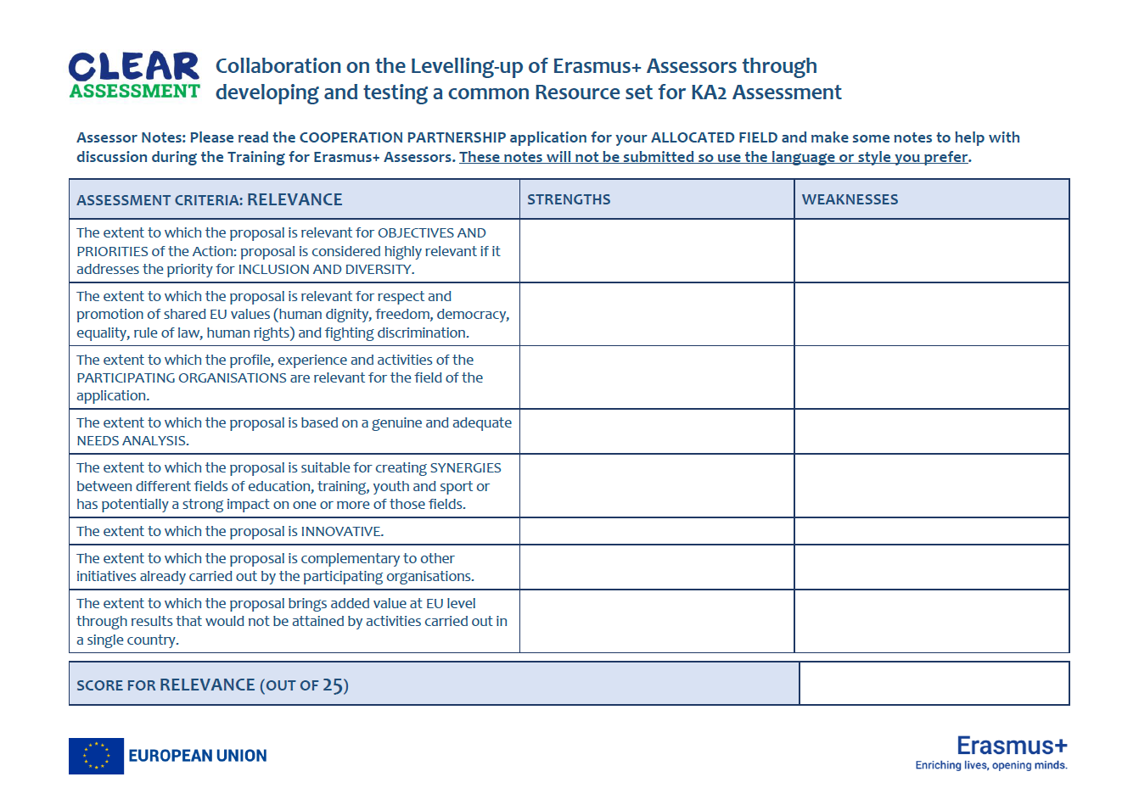
Notes:
GUIDELINES FOR ERASMUS+ NAs
As a part of the homework exercise, it can be useful to provide a template for assessors to record their thoughts. This screen shows an example of such a template. It is important, however, to confirm that this template is for the mock assessment exercise only and does not relate to the formal assessment exercise where strengths and weaknesses would come together in a single set of comments.
Note: materials developed for the Spring 2023 Assessor Training events in Ljubljana and Rotterdam will be shared with Erasmus+ National Agencies.

Slide 21
ACTIVITY 2: RELEVANCE
Plenary
Exchange
Notes:
GUIDELINES FOR ERASMUS+ NAs
Section Title Page: it can be useful to have a space to breathe between the different sections (and sub-sections) of the training.

Slide 22

Plenary Exchange
1. Did you agree on a single score (as a whole group, or as two sub-groups)?
2. What method or approach did you adopt when sharing perspectives?
3. Where there any difficulties? Were
some elements more complex than others?
RAPPORTEUR FEEDBACK
5
Notes:
GUIDELINES FOR ERASMUS+ NAs
This is a simple prompt for the plenary feedback session, providing a small number of questions against which the different groups (and sub-groups) will be invited to comment. Depending on the number of groups, and the time available, the time given to each rapporteur might need to be changed (usually 3 to 5 minutes per rapporteur).

Slide 23
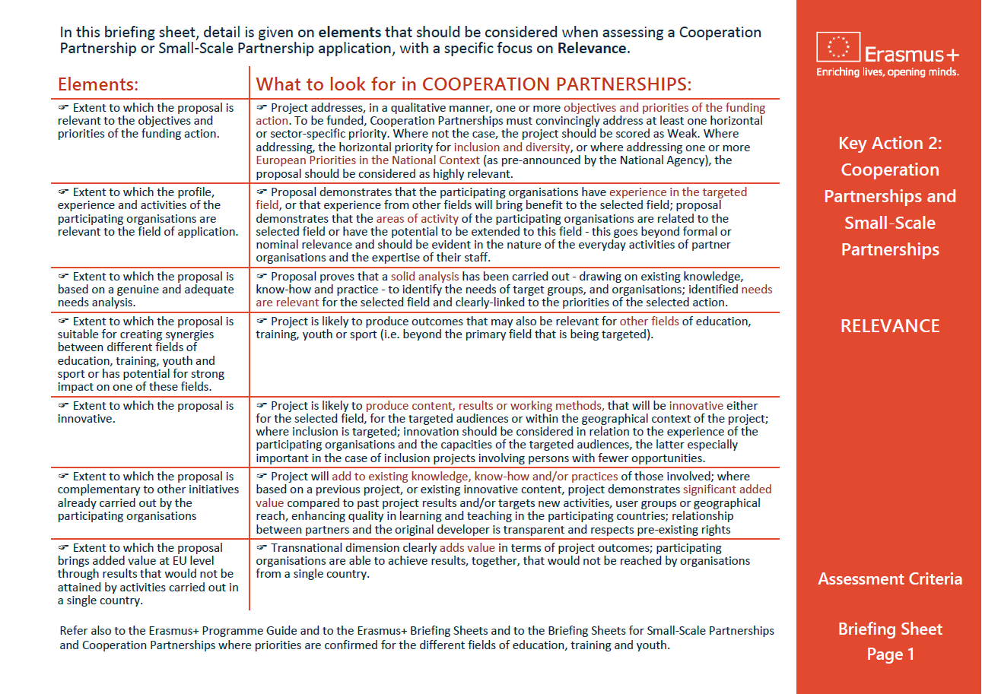
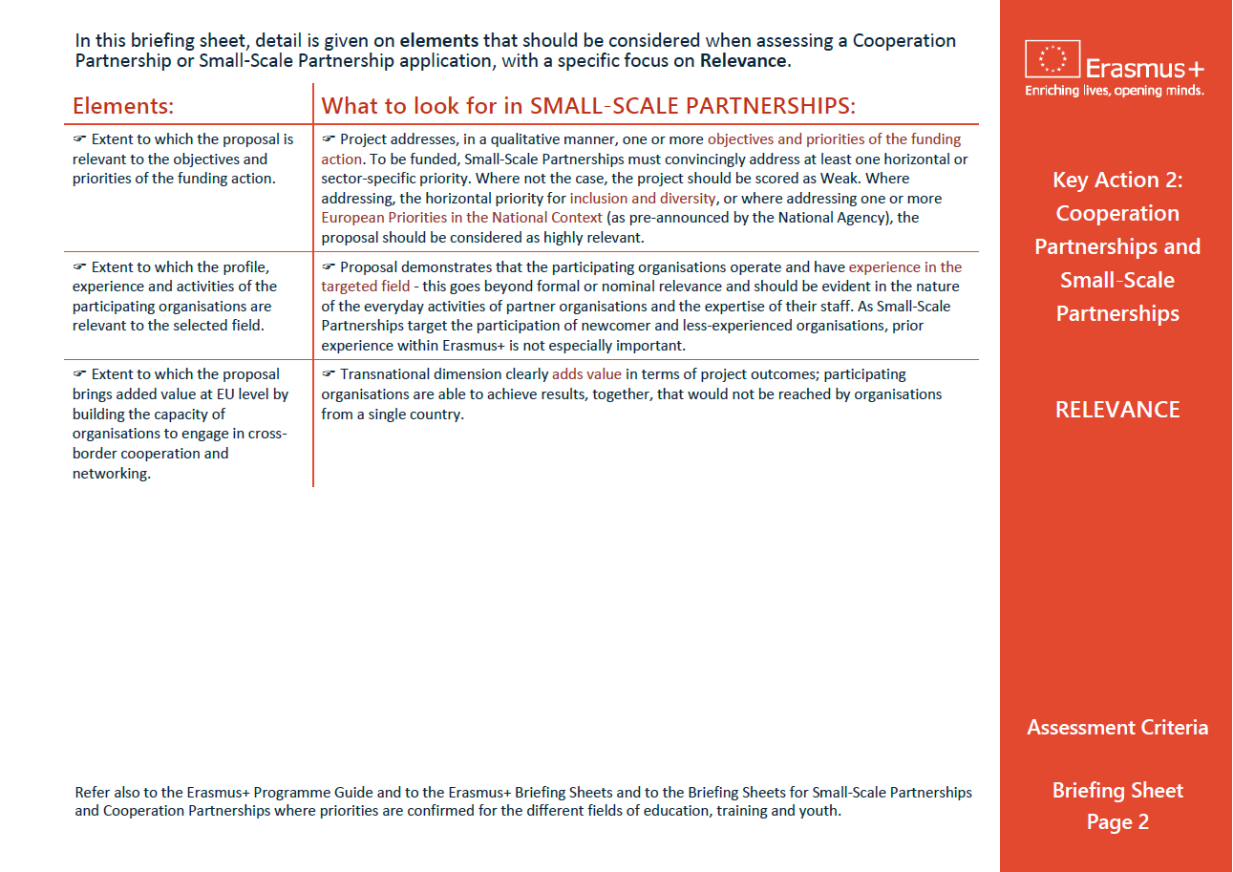
Relevance Briefing Sheet
Notes:
GUIDELINES FOR ERASMUS+ NAs
In this final slide, it can be useful to remind assessors of the availability of a written briefing sheet which confirms the key elements being judged under “RELEVANCE”.

