Slide 1




Collaboration on the Levelling-up of Erasmus+ Assessors through developing and testing a common Resource set for KA2 Assessment
Erasmus+ Assessor Training Workshop 2024
add location | add date
Notes:
GUIDELINES FOR ERASMUS+ NAs
This is the welcome screen. Add your own location and date.
You can also add your own logos but please retain the CLEAR, EU and Erasmus+ logos.

Slide 2

Welcome and Introduction
Notes:
GUIDELINES FOR ERASMUS+ NAs
Section Title Page: it can be useful to have a space to breathe between the different sections of the training.

Slide 3

12
4
3
One CLEAR Vision
E+
€€€
KA2
33
300+
FR+
Notes:
GUIDELINES FOR ERASMUS+ NAs
Single slide introduction to the CLEAR LTA using numbers (see definitions below). Feel free to change some of the numbers to underline important elements of your own event:
12 = NAs involved in the CLEAR LTA.
4 = Fields being addressed by the CLEAR LTA (ADU, HED, SCH and VET).
3 = Years of Activity for the CLEAR LTA.
E+ = programme financing and benefitting from CLEAR LTA Activity.
KA2 = focus of CLEAR LTA assessor training activities - specifically KA210 and KA220 which follow the indirect management approach.
€€€ = move to lump sum financing which underpins to targeted training for Erasmus+ KA2 assessors.
33 = number of countries invited to participate in initial training events in Ljubljana and Rotterdam in Spring 2023.
300+ = number of assessors and NA staff trained during 2022 and 2023.
FR+ = reminder that the focus is now moving to the training of assessors for Final Report assessment.

Slide 4
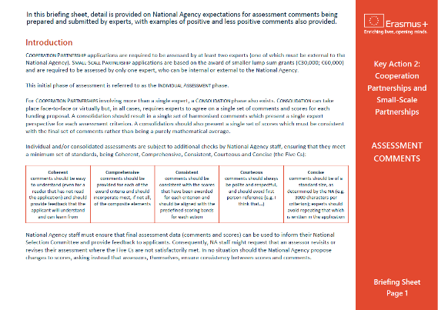
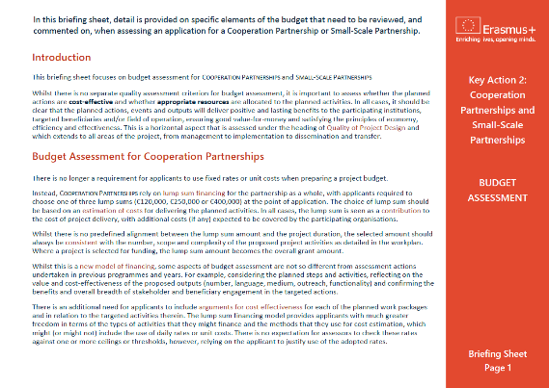

Additional Materials
Briefing Sheets
and Short Video
Notes:
GUIDELINES FOR ERASMUS+ NAs
A useful slide that allows you to mention that written Briefing Sheets also exist as well as a short animated video. Normally, the video is played as a part of the training session on Quality of Project Design. If you are not going to circulate these materials then you can remove this slide.

Slide 5

Learning Outcomes
Notes:
GUIDELINES FOR ERASMUS+ NAs
Important to use Learning Outcomes to encapsulate the targeted learning. These can be introduced as a whole set at the start of the training day, or used individually at the start of each training session.

Slide 6

By the end of this workshop, you will be able to:
1. DEMONSTRATE improved understanding of the key factors involved in determining the relevance of a KA220 (or KA210) funding proposal and APPLY this in your future assessments.
2. ASSESS the composition and quality of partnerships, REFLECT on their relevance to the selected field, to the targeted audiences and to the planned actions and outputs.
3. APPRAISE budgets and DETERMINE value-for-money,
using the data provided in proposals and workplans.
Notes:
GUIDELINES FOR ERASMUS+ NAs
Learning Outcomes 1-3: remember to adapt these to reflect those aspects of the training that you will use with your assessors.

Slide 7
By the end of this workshop, you will be able to:
4. DISTINGUISH between quantitative and qualitative indicators and DELIVER an informed opinion on the adequacy and sufficiency of indicators/measures/targets within KA220 funding proposals.
5. EVALUATE the validity of measures within KA210 and KA220 proposals, aimed at promotion and continued use of the
developed concepts, products and services.
Notes:
GUIDELINES FOR ERASMUS+ NAs
Learning Outcomes 4-5: remember to adapt these to reflect those aspects of the training that you will use with your assessors.

Slide 8

More than Just Reading
Notes:
GUIDELINES FOR ERASMUS+ NAs
Important to remind participants that this (physical or virtual) training event requires active participation, to ensure added-value from a simple review of documents.

Slide 9

Programme and Timing
Notes:
GUIDELINES FOR ERASMUS+ NAs
Section Title Page: it can be useful to have a space to breathe between the different sections of the training.

Slide 10
MONDAY 11 MARCH 2024 [example]
15:00 Welcome and Introduction
15:15 Icebreaker and Group Formation
15:30 Erasmus+ Quiz
15:50 Activity 1 - Quality of Partnership
16:00 Assessment Scores
18:15 Close of Day One
19:15 COMMON DINNER (SS Rotterdam)
TUESDAY 12 MARCH 2024 [example]
09:00 WELCOME BACK AND ENERGISER
09:15 Activity 2 - Relevance
10:30 COFFEE BREAK
11:00 Activity 2 - Relevance (continued)
12:00 LUNCH BREAK
13:15 Activity 3 - Quality of Project Design
15:30 COFFEE BREAK
16:00 Activity 3 - Quality of Project Design (continued)
17:00 Assessment Comments
17:30 Close of Day Two
18:45 Walk to Nhow Rotterdam
19:30 COMMON DINNER (Nhow Rotterdam Restaurant)
Notes:
GUIDELINES FOR ERASMUS+ NAs
Event Programme Part 1: slide for presenting an outline programme and schedule (example based on Days 1 and 2 of a previous Assessor Training Event). Important to update this with your own training programme.

Slide 11



WEDNESDAY 13 MARCH 2024 [example]
09:00 WELCOME BACK, ENERGISER AND OVERVIEW
09:15 Activity 4 - Impact
10:30 COFFEE BREAK
11:00 Activity 4 - Impact (continued)
12:00 Consolidation Process
12:30 CLOSE OF EVENT, LUNCH AND DEPARTURE
Notes:
GUIDELINES FOR ERASMUS+ NAs
Event Programme Part 2: slide for presenting an outline programme and schedule (example based on Day 3 of a previous Assessor Training Event). Important to update this with your own training programme.

Slide 12

Icebreaker Session
Notes:
GUIDELINES FOR ERASMUS+ NAs
Section Title Page: it can be useful to have a space to breathe between the different sections of the training.

Slide 13

Erasmus+ Assessor Experience
Notes:
GUIDELINES FOR ERASMUS+ NAs
Icebreaker Example 1: this is suitable for a physical event where participants are asked to form a snake ranging from the HIGHEST number of years or assessment (head of the snake) to the LOWEST numbers of years of assessment (tail of the snake); this exercise requires a fairly large space but it is also easy to work around tables and chairs as you only need a single line/snake to be formed; this is a good exercise for highlighting the range of experience present in the room but it is also important to highlight that everybody has a role to play, irrespective of the number of years (or months) of experience.

Slide 14
Winter Slopes
(Ski)
Summer Sun
(Beach)
Exercise and Adventure
Something Else
Ideal Holiday
Notes:
GUIDELINES FOR ERASMUS+ NAs
Icebreaker Example 2: simple exercise where participants are invited to indicate their presence; in a physical event, participants are invited to stand in a corner or next to a written sign which shows their preference; in a virtual event, participants might vote as a way of showing their preference; in all cases, this is a fun way of showing diversity among participants.

Slide 15
Mediterranean
(Pasta, Pizza, Salad, Grill)
Meat Meat
Meat
Veggie Paradise
Something Else
Ideal Meal
Notes:
GUIDELINES FOR ERASMUS+ NAs
Icebreaker Example 3: alternative version of Icebreaker Example 2 (different topic). Sometimes, it can be fun to have multiple icebreaker questions to get people energised and engaged.

Slide 16



Something Else
Assessor Type
Notes:
GUIDELINES FOR ERASMUS+ NAs
Icebreaker Example 4: this exercise is similar to Icebreaker Examples 2 and 3 but with a focus on assessment types, where the WHALE is seen as empathic being able to share and understand the feelings of others, the ELEPHANT recognises their role in the herd being part of something that contributes to the common good and the LION is fierce and protective (i.e. looking for faults in proposals and protecting European funds). Again., a fun icebreaker but one which focuses on showing diversity among assessors. Often participants will chose SOMETHING ELSE when they do not feel comfortable with any of the other descriptions (e.g. part lion, part whale).

Slide 17

One More Question!
Notes:
GUIDELINES FOR ERASMUS+ NAs
Bridging Page: helps to move on to the next question.

Slide 18
ADU
HED
SCH
VET
Erasmus+ Fields
Notes:
GUIDELINES FOR ERASMUS+ NAs
Following on from the icebreakers, and whilst participants are still standing (mostly relevant to physical events), it can be useful to group participants under the different fields of education and training, which can be the basis for the next exercise: Group Quiz.

Slide 19

Group
Quiz
A Few Minutes to Say Hello
One Digital Entry per Table
Notes:
GUIDELINES FOR ERASMUS+ NAs
A Group Quiz achieves two goals simultaneously. Firstly, it is a chance for field-specific teams to work together, which is something that they will do during other parts of the training. Secondly, it is a chance to confirm existing knowledge levels on some of the basic aspects of the Erasmus+ programme (i.e. a quick instead of a short presentation).
Digital platforms or smartphone applications can be a fun way of engaging participants in a short quiz. Many platforms and applications exist so it is important to select one that you are comfortable with and know how to use. You might also have to check what licenses you have in your own organisation as free platforms or application often impose limits on the number of questions or the number of respondents. In all cases, a single response should be able to be submitted by each GROUP or TEAM. A QR code can also make it easier to access a digital platform or application.

Slide 20



Site: add URL
Session ID: add code or QR
Notes:
GUIDELINES FOR ERASMUS+ NAs
In a recent quiz, a series of 5 multiple choice questions were used, namely:
1. Erasmus+ allows for different levels of participation among "EU Countries and those Associated to the Programme" and "Countries Not Associated to the Programme". Looking beyond the EU27, which are the SIX ASSOCIATED COUNTRIES? [Albania / Bosnia and Herzegovina / Croatia / Georgia / Iceland / Liechtenstein / North Macedonia / Norway / Serbia / Switzerland / Türkiye / Ukraine] six correct answers are underlined
2. For the programme period 2021-2027, which of the following represent the FOUR HORIZONTAL PRIORITIES of the Erasmus+ programme? [Inclusion and Diversity / Recognition and Validation of Learning and Skills / Key Competences / Digital Transformation / Teaching Excellence / Democratic Life, Common Values and Civic Engagement / Multilingualism / Excellence in STEM-STEAM / Environment and Fight against Climate Change / Quality Assurance] four correct answers are underlined
3. For proposals under Cooperation Partnerships (KA220), which of these statements is correct? [At least ONE quality assessment is required / At least TWO quality assessments are required / At least THREE quality assessments are required/ ONE OR TWO quality assessments might be required - depending on the value of the lump sum requested] one correct answer is underlined
4. When assessing project proposals under Key Action 2 Partnerships for Cooperation, what are the FOUR AWARD CRITERIA that are used? [Relevance / European Added-Value / Quality of Work Programme and Budget / Dissemination and Exploitation / Impact / Quality of Consortium / Quality of Project Design and Implementation / Value-for-Money / Quality of Partnership and Cooperation Arrangements] four correct answers are underlined
5. Which of the following statements is correct in relation to the minimum score required for a Cooperation Partnership (KA220) to be considered for financing? [To be considered for funding, proposals need only score 60 points in total / To be considered for funding, proposals must score at least 60 points in total plus at least half of the maximum score under RELEVANCE only / To be considered for funding, proposals must score at least 60 points in total plus at least half of the maximum score under ALL four award criteria / To be considered for funding, proposals must score at least 70 points in total plus at least half of the maximum score under ALL four award criteria] one correct answer is underlined (updated for 2024)
6. Across both Partnership for Cooperation actins (KA210 and KA220) which of the following are eligible lump sums?- the larger of the two partnership actions - which of the following are eligible lump sums? [€30,000 / €60,000 / €120,000 / €150,000 / €250,000 / €300,000 / €350,000 / €400,000 / €500,000) five correct answers are underlined
7. What is maximum number of Work Packages that is allowed within a Cooperation Partnership (KA220)? [No Maximum - No Limit Applied / Maximum of 5 WPs - including the required WP for Project Management / Maximum of 6 WPs - including the required WP for Project Management / Maximum of 7 WPs - including the required WP for Project Management / Maximum of 10 WPs - including the required WP for Project Management] one correct answer is underlined (fun point for discussion based on the fact that the Erasmus+ programme guide advises applicants to “split their projects in a maximum of 5 works packages, including the one on project management”… but this is not an eligibility criterion).
Different questions can be used in your own event, and you can choose different options to add for multiple choice questions.

