Slide 1


Consolidation Process
Notes:
GUIDELINES FOR ERASMUS+ NAs
Section Title Page: it can be useful to have a space to breathe between the different sections of the training.

Slide 2

Quality Assessment and Quality Assurance
Five Cs
Coherent comments should be easy to understand - even for someone that has not read the proposal - and should provide feedback that the applicant will understand and can learn from | Comprehensive comments should be provided for each of the award criteria (written text, not bullet points) and should incorporate most or all of the composite elements | Consistent comments should be consistent with scores that have been awarded for each criterion and should be aligned with the predefined scoring bands for each action | Courteous comments should always be polite and respectful, and should avoid first person references (e.g. I think that, I suggest that…) | Concise comments must be within the maxima accepted by the online evaluation tool (usually 3000 characters); experts should also avoid repeating that which is written in the application
Six Cs (one additional element)
CONSOLIDATED written texts should be presented as a single set of harmonised comments in which there are no areas of contradiction; consolidated scores should be consistent with final written comments and not (in all cases) a simple mathematical average.
Notes:
GUIDELINES FOR ERASMUS+ NAs
This slide presents the model of 5*Cs, each of which should be briefly introduced. It is especially important to underline that it is the responsibility of all Erasmus+ National Agencies to quality assure the work of their assessors. This initial input forms an important baseline for this activity on comments.
The sixth C is especially important to mention in this case as it relates to the overall topic of this activity, namely CONSOLIDATION.
It is important to remind assessors of the need to bring opinions together in a single set of harmonised comments rather than simply trying to get a equal balance of words and input from the two assessors.

Slide 3

CONSULT
Change of Role
Make Your Choice
CONVERSE
COMBINE
Notes:
GUIDELINES FOR ERASMUS+ NAs
Participants are asked to visualise themselves as lead assessor with responsibility for drafting the CONSOLIDATION and already having access to both sets of comments and scores. The following concepts should also be introduced:
COMBINE: preferred option for consolidation where comments from the two assessors are very similar and with no significant differences of opinion; normally a desk-based exercise in which draft comments are created prior to agreeing with the second assessor via a short meeting or exchange of emails.
CONVERSE: preferred option where comments from the two assessors are differ in one or more areas; normally involves a short meeting or call for each assessor to present their opinion and for agreement be sought; meeting or conversation should take place prior to drafting consolidated comments.
CONSULT: preferred option where comments from the two assessors differ on fact-based issues (e.g. number of partners; involved countries); in all such cases, it is important to consult the proposal to ensure that comments are correct; suggested to avoid quantitative references in written texts unless absolutely necessary, limiting the potential for misinterpretation.

Slide 4

COMBINE
CONVERSE
CONSULT
What Would You Do?
Notes:
GUIDELINES FOR ERASMUS+ NAs
In the exercise, participants will be asked whether they would COMBINE, CONVERSE or CONSULT either by standing or raising hands when a specific category is called out (e.g. all those who would COMBINE please raise their hand) or, more effectively, by raising a red, orange or green card.

Slide 5
Consolidation Process: What Action is Required?
COMBINE
CONVERSE
CONSULT
Assessor 1: Evaluation plans are clearly stated and it is positive to see ambitions for securing feedback from participating learners in school and work-based settings. Assessor 2: Evaluation plans are outlined yet specific performance indicators are lacking.
Notes:
GUIDELINES FOR ERASMUS+ NAs
Ask participants to vote using your chosen method (e.g. raise hands, show cards). Invite 1 or 2 participants to justify their decision before sharing your own perspective.
The preferred approach in this case would be to CONSULT and possibly CONVERSE: firstly, it is important to check whether performance indicators are actually lacking (it could be that assessor 1 missed this point); where so, it is fairly easy to proposed a common text, where not the case, a conversation will be needed to find agreement on this aspect among the two assessors.
Note: if working with additional actions (e.g. KA1) or delivering this training over multiple years, assessor comments should be updated.

Slide 6
Consolidation Process: What Action is Required?
COMBINE
CONVERSE
CONSULT
Assessor 1: Ambitions for involving non-traditional learner audiences are positive and sufficient insight is given into how this expects to be achieved, specifically. Assessor 2: Whilst having valid plans for engaging non-traditional learner audiences in the targeted training programmes, the level of detail provided is fairly minimal.
Notes:
GUIDELINES FOR ERASMUS+ NAs
Ask participants to vote using your chosen method (e.g. raise hands, show cards). Invite 1 or 2 participants to justify their decision before sharing your own perspective.
The preferred approach in this case would be to CONVERSE: there are different opinions presented on the issue of how non-traditional learner audiences are to be involved and agreement needs to be sought among the two assessors.
Note: if working with additional actions (e.g. KA1) or delivering this training over multiple years, assessor comments should be updated.

Slide 7
Consolidation Process: What Action is Required?
COMBINE
CONVERSE
CONSULT
Assessor 1: The roles of partners are fairly well explained and task attribution is consistent with existing partner experience and expertise. Assessor 2: Insufficient insight is given into the role that will be played by employers in training delivery.
Notes:
GUIDELINES FOR ERASMUS+ NAs
Ask participants to vote using your chosen method (e.g. raise hands, show cards). Invite 1 or 2 participants to justify their decision before sharing your own perspective.
The preferred approach in this case would be to CONSULT and possibly CONVERSE: firstly, it is important to check whether the reference to employers is the same as the reference to partners or whether these are different entities that expect to be engaged in different ways. Where these are different entities, it is fairly easy to proposed a common text, where these are the same entities then a conversation will be needed to find agreement on this aspect among the two assessors.
Note: if working with additional actions (e.g. KA1) or delivering this training over multiple years, assessor comments should be updated.

Slide 8
Consolidation Process: What Action is Required?
COMBINE
CONVERSE
CONSULT
Assessor 1: Plans for delivering entrepreneurship training for learners and staff are clear and appropriate, with adequate justification for not including all partners in these activities. Assessor 2: Entrepreneurship training forms an important part of the project yet little indication is given of how this is to be delivered, specifically.
Notes:
GUIDELINES FOR ERASMUS+ NAs
Ask participants to vote using your chosen method (e.g. raise hands, show cards). Invite 1 or 2 participants to justify their decision before sharing your own perspective.
The preferred approach in this case would be to CONVERSE: there are different opinions presented on the perceived level of clarity and insight on plans for delivering entrepreneurship training and agreement needs to be sought among the two assessors.
Note: if working with additional actions (e.g. KA1) or delivering this training over multiple years, assessor comments should be updated.

Slide 9
Consolidation Process: What Action is Required?
COMBINE
CONVERSE
CONSULT
Assessor 1: Considering the number of planned activities, as well as targets for participation, the proposed lump sum is unjustified and a reduced grant amount should be considered. Assessor 2: Budget forecasts are not excessive taking into account the size of the consortium, the planned activities and the total number of number learners that will participate.
Notes:
GUIDELINES FOR ERASMUS+ NAs
Ask participants to vote using your chosen method (e.g. raise hands, show cards). Invite 1 or 2 participants to justify their decision before sharing your own perspective.
The preferred approach in this case would be to CONVERSE: as well as having a difference of opinion on budget justification, it is also important to acknowledge that an increase or reduction to the budget is NOT ALLOWED for KA210 or KA220 thus agreement will need to be sought among the two assessors on the adequacy (or not) of the proposed budget and lump sum.
Note: if working with additional actions (e.g. KA1) or delivering this training over multiple years, assessor comments should be updated.

Slide 10
Consolidation Process: What Action is Required?
COMBINE
CONVERSE
CONSULT
Assessor 1: A good range of marketing and promotional actions is outlined, with positive ambitions for promoting results and successes within and beyond the applicant institution. Assessor 2: Whilst a sufficient range of dissemination tools and channels is proposed, less is said of how the selected tools might be targeted for use with specific stakeholder audiences.
Notes:
GUIDELINES FOR ERASMUS+ NAs
Ask participants to vote using your chosen method (e.g. raise hands, show cards). Invite 1 or 2 participants to justify their decision before sharing your own perspective.
The preferred approach in this case would be to COMBINE: there are different aspects highlighted by the two assessors but they are not conflicting and it should be easy enough to present a single constructive comment. If assessor 1 preferred to include a more positive comment, they could also CONSULT the proposal again to see if there is indeed a lack of detail of targeted stakeholder approaches. Where not the case, they might also CONVERSE with assessor 2 to secure their agreement on this point.
Note: if working with additional actions (e.g. KA1) or delivering this training over multiple years, assessor comments should be updated.

Slide 11
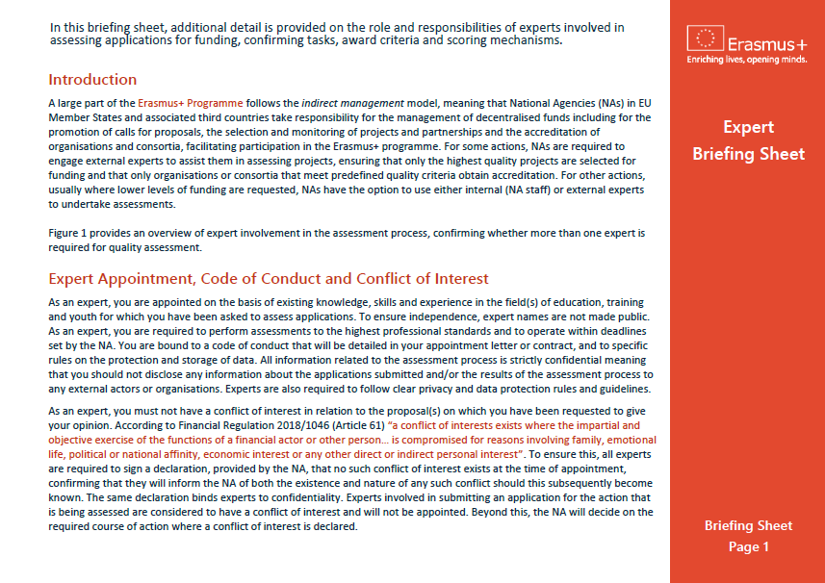
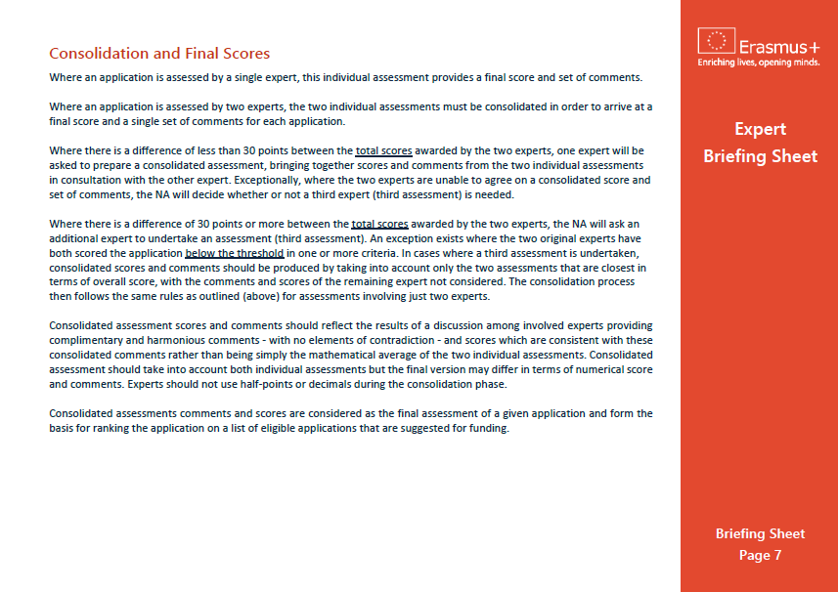
Expert Briefing Sheet
Notes:
GUIDELINES FOR ERASMUS+ NAs
This final slide, it can be useful to remind assessors of the availability of a written “EXPERT BRIEFING SHEET” which provides an overview of individual and consolidated assessment and the roles of expert assessors.

