Slide 1


Assessment Comments
Notes:
GUIDELINES FOR ERASMUS+ NAs
Section Title Page: it can be useful to have a space to breathe between the different sections of the training.

Slide 2
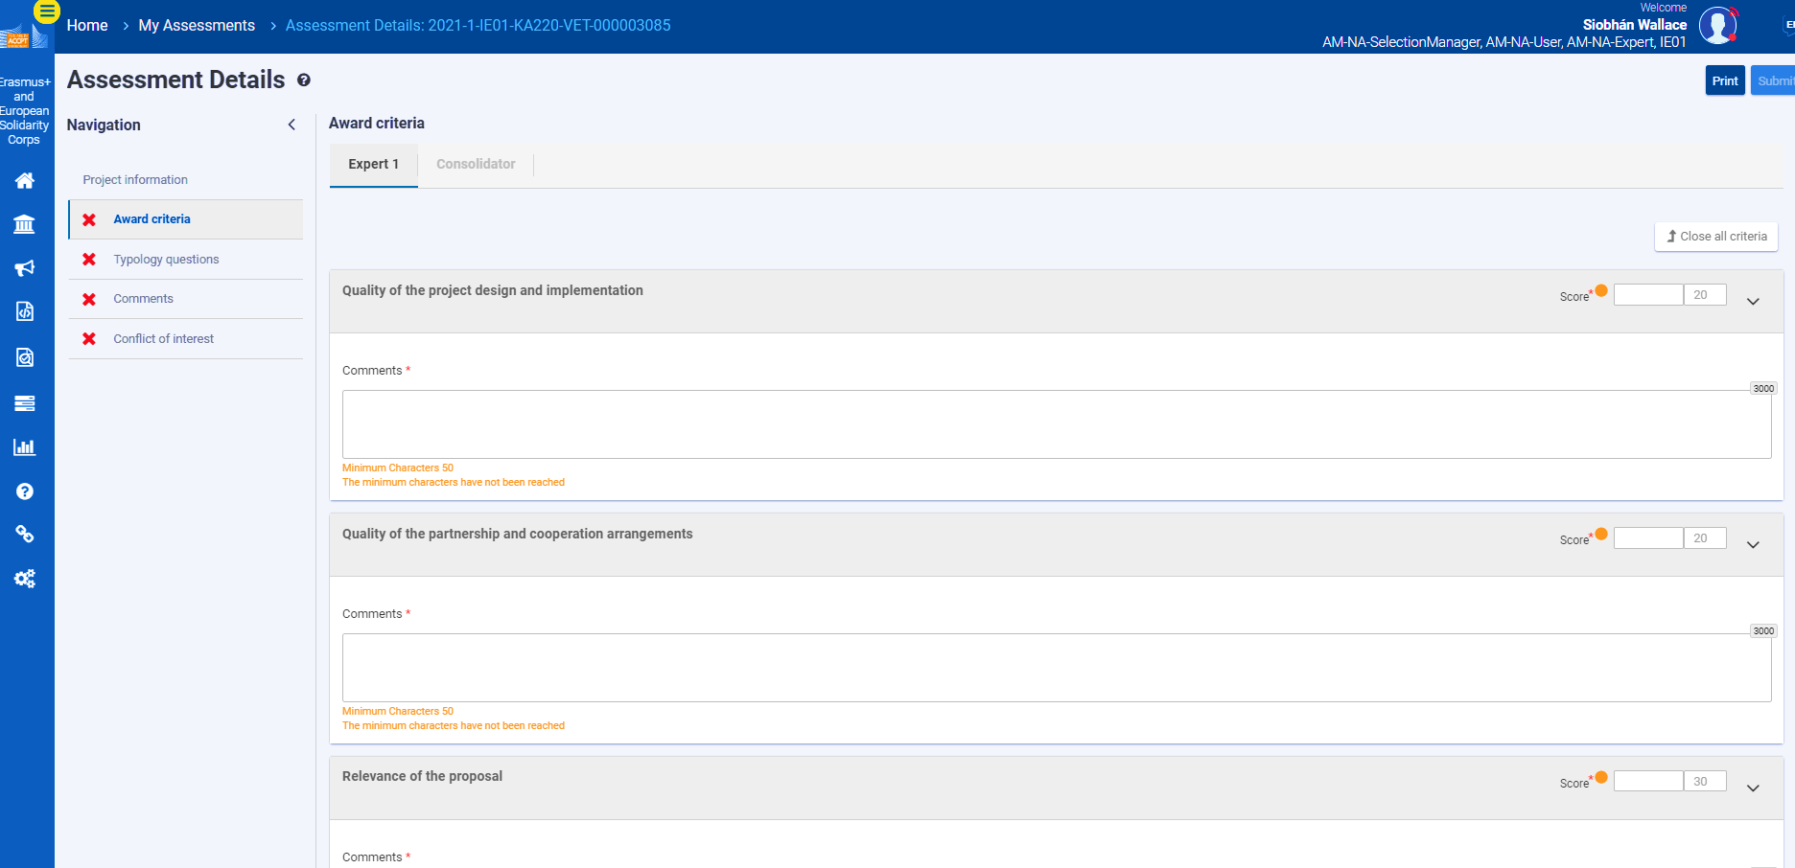
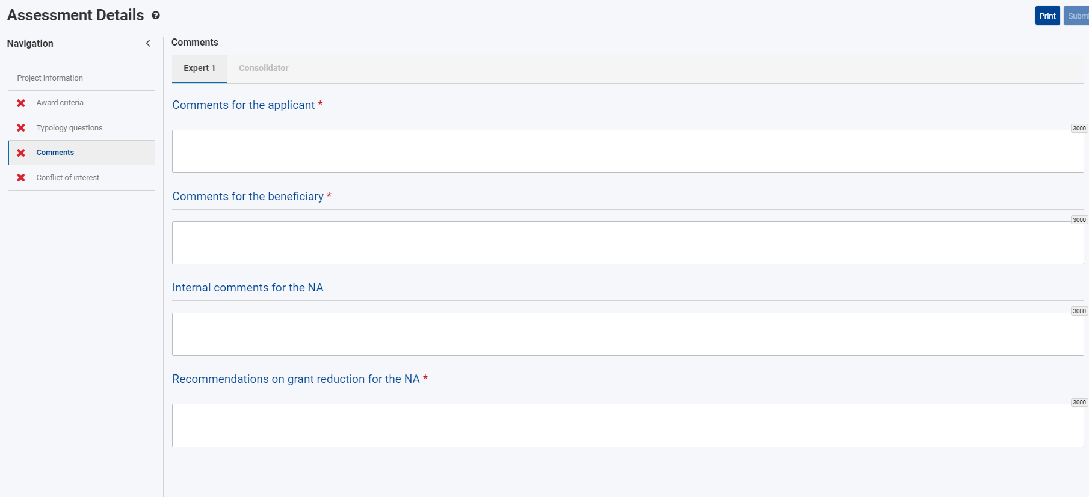
Quality Assessment: Online Assessment Form
Comments for each Assessment Criterion
scores for each assessment criterion (refer to scoring bands and thresholds)
Total calculated automatically.
Comments for
the Applicant (strengths and weaknesses)
Remember that different maxima exist for different assessment criteria
Comments
for the
National Agency
SAVE YOUR WORK
and keep a back up
Budget Recommendations
Notes:
GUIDELINES FOR ERASMUS+ NAs
This slide can be used to present a short overview of the online assessment platform/module. If you are having a dedicated presentation of the assessment platform/module then you can remove this slide.
At this point, you can also mention whether an MS Word template exists and can/should be used.

Slide 3

Quality Assessment and Quality Assurance
Five Cs
Coherent comments should be easy to understand - even for someone that has not read the proposal - and should provide feedback that the applicant will understand and can learn from | Comprehensive comments should be provided for each of the award criteria (written text, not bullet points) and should incorporate most or all of the composite elements | Consistent comments should be consistent with scores that have been awarded for each criterion and should be aligned with the predefined scoring bands for each action | Courteous comments should always be polite and respectful, and should avoid first person references (e.g. I think that, I suggest that…) | Concise comments must be within the maxima accepted by the online evaluation tool (usually 3000 characters); experts should also avoid repeating that which is written in the application
Six Cs (one additional element)
CONSOLIDATED written texts should be presented as a single set of harmonised comments in which there are no areas of contradiction; consolidated scores should be consistent with final written comments and not (in all cases) a simple mathematical average.
Notes:
GUIDELINES FOR ERASMUS+ NAs
This slide presents the model of 5*Cs, each of which should be briefly introduced. It is especially important to underline that it is the responsibility of all Erasmus+ National Agencies to quality assure the work of their assessors. This initial input forms an important baseline for this activity on comments.
The sixth C can also be mentioned but relates mainly to consolidation for which a separate activity has been prepared.

Slide 4

REJECT
Change of Role
Make Your Choice
UNSURE
ACCEPT
Notes:
GUIDELINES FOR ERASMUS+ NAs
For this activity, participants should be told that they will play the role of a member of NA staff and that they need to decide whether the written comments align with the model of the 5*Cs and whether they choose to ACCEPT or REJECT the written comments. This can be done by standing or raising hands when a specific category is called out (e.g. all those who ACCEPT this please raise their hand) or, more effectively, by raising a red or green card. An orange card can also be used by assessors that are unsure. This can also be done by raising RED and GREEN cards at the same time (i.e. red and green = orange).

Slide 5

ACCEPT
UNSURE
REJECT
What Would You Do?
Notes:
GUIDELINES FOR ERASMUS+ NAs
Section Prompt: it can be useful to have a space to breathe before starting the activity.

Slide 6
Assessment Comments for Relevance: Accept or Reject
ACCEPT
UNSURE
REJECT
The proposal brings together a mixture of partners extending to four EU and associated third countries. Partners represent two distinct fields of activity, covering education and industry. The selected priorities are correctly stated and a number of national and European policies are also listed (European Skills Agenda; regional development plans). Innovation is described and complementarity is addressed by presenting a list of past projects covering most of the partners. European added-value is argued from the perspective that materials will be delivered in multiple partner languages and made available to countries and institutions beyond the initial partnership.
Notes:
GUIDELINES FOR ERASMUS+ NAs
Ask participants to vote using your chosen method (e.g. raise hands, show cards). Invite 1 or 2 participants to justify their decision before sharing your own perspective.
This comment would normally be REJECTED for the following reason: there are lots of statements but no real qualitative assessment or opinion is provided.
Note: if working with additional actions (e.g. KA1) or delivering this training over multiple years, comments should be updated.

Slide 7
Assessment Comments for Relevance: Accept or Reject
ACCEPT
UNSURE
REJECT
The proposed project is relevant and partners have relevant experience in the selected field. Needs analysis is adequate. Innovation and complementarity are clear. European added-value is well argued.
Notes:
GUIDELINES FOR ERASMUS+ NAs
Ask participants to vote using your chosen method (e.g. raise hands, show cards). Invite 1 or 2 participants to justify their decision before sharing your own perspective.
This comment would normally be REJECTED for the following reason: whilst positive to see qualitative statements included, there is minimal detail presented with statements mostly representing a simple affirmation of aspects covered by the sub-criterion.
Note: if working with additional actions (e.g. KA1) or delivering this training over multiple years, comments should be updated.

Slide 8
Assessment Comments for Relevance: Accept or Reject
ACCEPT
UNSURE
REJECT
The planned actions have the potential to innovate existing education-industry collaboration, including through the planned knowledge hubs. European added-value is well explained and there are valid ambitions for multi-country knowledge exchange and capacity-building. Wider outreach ambitions are convincingly explained and detailed. The proposal is appropriate to the selected action and alignment with the chosen priorities is clearly illustrated with valid ambitions for developing partnerships between education and industry in the four participating countries. It is positive to see direct participation from relevant educational partners delivering technology-based courses and programmes as well as from small and large companies in each of the four partner countries. Goals are pertinent and relevant European policies are additionally referenced alongside specific development objectives for the participating countries and regions.
Notes:
GUIDELINES FOR ERASMUS+ NAs
Ask participants to vote using your chosen method (e.g. raise hands, show cards). Invite 1 or 2 participants to justify their decision before sharing your own perspective.
This comment would normally be REJECTED for the following reason: there are lots of valid statements made, including the necessary level of detail and qualitative interpretation, but the text is dense and difficult to read and digest. The assessor would be encouraged to re-present using smaller texts that align specifically with the different sub-criteria, and in the order that these sub-criteria are represented in the Guide for Assessors.
Note: if working with additional actions (e.g. KA1) or delivering this training over multiple years, comments should be updated.

Slide 9
Assessment Comments for Relevance: Accept or Reject
ACCEPT
UNSURE
REJECT
The goals of the project are relevant to the objectives and priorities of the funding action, although the remit of the project is not hugely ambitious. I cannot see why the focus is on technology subjects only when there are many other subjects that would benefit from such an approach. This reduces the potential reach of the proposal and I suggest that partners extend the focus of the knowledge partnerships to a wider range of subject areas. Partners are relevant to the targeted sector but this could be strengthened by adding additional industry partners. Needs analysis is valid and sufficient insight is given into the targeted innovations, albeit in a single sector. It is not fully clear how the proposed actions complement existing initiatives in the different partner countries, with many good examples already available at: https://ec.europa.eu/programmes/erasmus-plus/projects_en. European added-value is evident considering plans for knowledge exchange and wider outreach.
Notes:
GUIDELINES FOR ERASMUS+ NAs
Ask participants to vote using your chosen method (e.g. raise hands, show cards). Invite 1 or 2 participants to justify their decision before sharing your own perspective.
This comment would normally be REJECTED for the following reasons: judgements are personal (first person should be avoided in written comments) and lots of comments are made on how the project could be improved rather than judging it according to the detail provided (constructive feedback can be provided but it is not the role of the assessor to re-define the project). In all cases, assessments should be base don that which is written in the proposal and not third party sources.
Note: if working with additional actions (e.g. KA1) or delivering this training over multiple years, comments should be updated.

Slide 10
Assessment Comments for Relevance: Accept or Reject
ACCEPT
UNSURE
REJECT
The proposal is appropriate to the selected action and the chosen priorities, with clear ambitions for developing partnerships between education and industry. It is positive to see direct participation from relevant educational partners, operating in the targeted field, as well as from companies in each of the four partner countries. Needs are convincingly outlined and sufficient insight is given into how needs were determined. Synergies are confirmed, with definite potential for additional use in the adult education sector. The planned actions have definite potential for innovating existing education-industry collaboration, in the participating institutions and beyond, including through the planned knowledge hubs. Complementarity with the current and past initiatives is clearly underlined. European added-value is well explained and there are valid ambitions for multi-country knowledge exchange and capacity-building. Wider outreach ambitions are also convincing.
Notes:
GUIDELINES FOR ERASMUS+ NAs
Ask participants to vote using your chosen method (e.g. raise hands, show cards). Invite 1 or 2 participants to justify their decision before sharing your own perspective.
This comment would normally be ACCEPTED for the following reason: comments are clear, comprehensive, easy to comprehend, courteous and related specifically to the proposal - without unnecessarily repeating the original text of the proposal - and provide the necessary qualitative opinion and judgement.
Note: if working with additional actions (e.g. KA1) or delivering this training over multiple years, comments should be updated.

Slide 11
Assessment Comments for Relevance: Accept or Reject
ACCEPT
UNSURE
REJECT
I cannot see how a change in practice will be brought about by delivering a series of monthly meetings. A full commitment to continued cooperation and partnership is not provided and I expect that industry partners will soon lose interest in the project, as the benefits for them are very few. Whilst arguments are presented for innovation, I do not agree with all that is written: how can it be innovative if the partners are already known to each other! Crazy! The needs analysis report also emerges from another European project, which cannot be allowed. I do not see the added-value of transnational collaboration in what is ultimately a series of small, local partnerships. How does Europe benefit from this?
Notes:
GUIDELINES FOR ERASMUS+ NAs
Ask participants to vote using your chosen method (e.g. raise hands, show cards). Invite 1 or 2 participants to justify their decision before sharing your own perspective.
This comment would normally be REJECTED for the following reason: judgements are personal (first person should be avoided in written comments) and not in all cases courteous or polite. References to something as being “not allowed” should be avoided as this could be contested later. Some aspects go beyond the listed sub-criteria and should be removed (e.g. potential for industry to lose interest).
Note: if working with additional actions (e.g. KA1) or delivering this training over multiple years, comments should be updated.

Slide 12
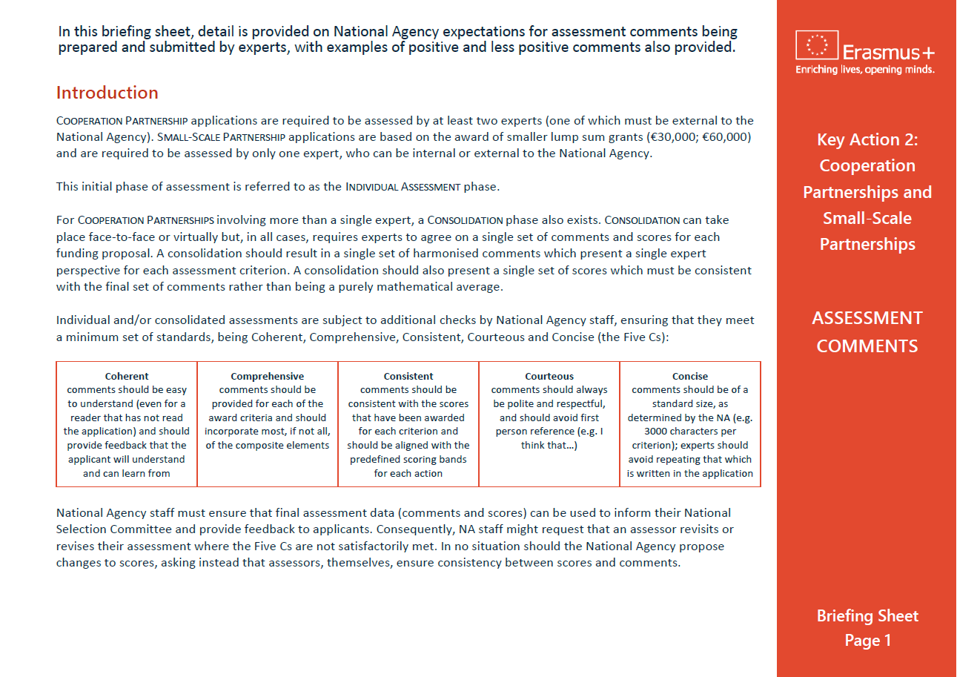
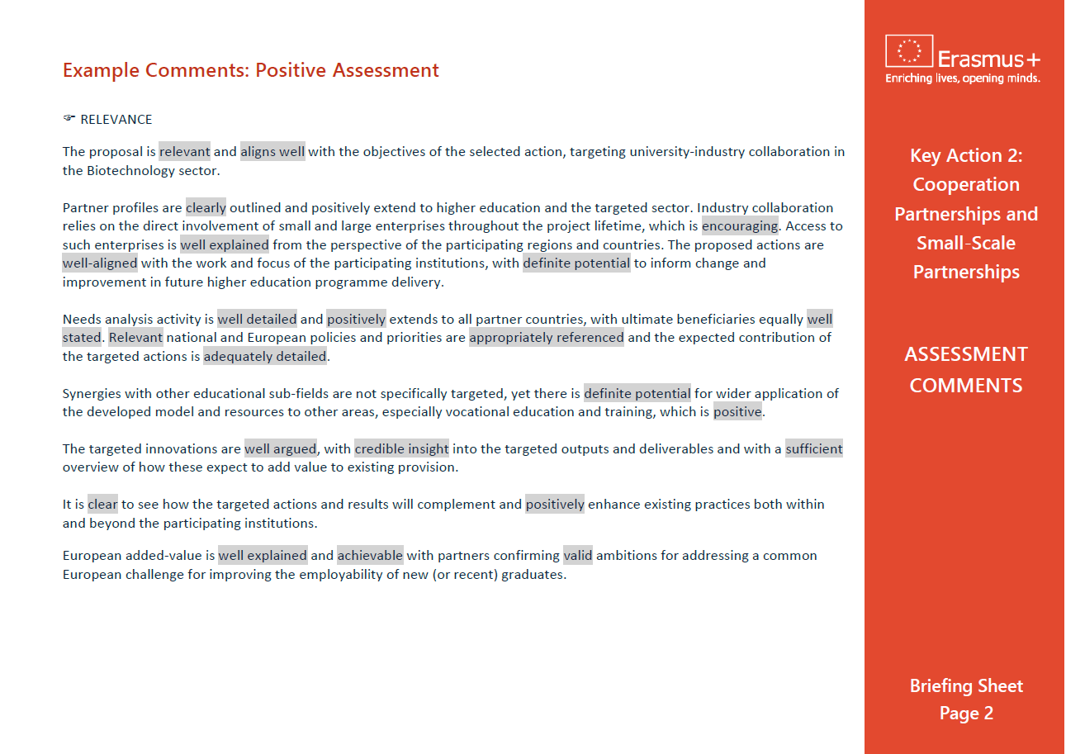
Assessment Comments Briefing Sheet
Notes:
GUIDELINES FOR ERASMUS+ NAs
This final slide can be useful to remind assessors of the availability of a written briefing sheet which provides positive and less positive examples of “ASSESSMENT COMMENTS” under the four KA2 assessment criteria.

