Slide 1


ACTIVITY 3: PROJECT DESIGN
Introduction
Notes:
GUIDELINES FOR ERASMUS+ NAs
Section Title Page: it can be useful to have a space to breathe between the different sections (and sub-sections) of the training.

Slide 2

Learning Outcomes:
DEMONSTRATE understanding of the key factors involved in determining quality of project design
APPRAISE budgets and DETERMINE value-for-money, using the data provided in proposals and workplans
Notes:
GUIDELINES FOR ERASMUS+ NAs
Learning Outcomes for A3-PROJECT DESIGN: adapt these to reflect what you will actually deliver or address during your assessor training event.

Slide 3

Nine Slides in Nine Minutes
Notes:
GUIDELINES FOR ERASMUS+ NAs
This follows the concept of keeping things simple and promoting the use of active and peer learning approaches during the training session. Each of the core elements being judged under QUALITY OF PROJECT DESIGN is to be quickly introduced, highlighting key aspects but keeping the introduction short to allow for participants to go forward and work in groups.

Slide 4

OBJECTIVES
Notes:
GUIDELINES FOR ERASMUS+ NAs
This relates to the sub-criterion for “project objectives are clearly defined, realistic and address the needs and goals of the participating organisations and the needs of their target groups”. The idea of this slide is to underline the importance of clear and SMART (specific, measurable, achievable, realistic and timebound) objectives, confirming that these should be a means for the assessor to visualize project delivery. In all cases, objectives should be easy to relate to the overall project aim and should provide a clear means of addressing identified needs for one or more target audiences.

Slide 5
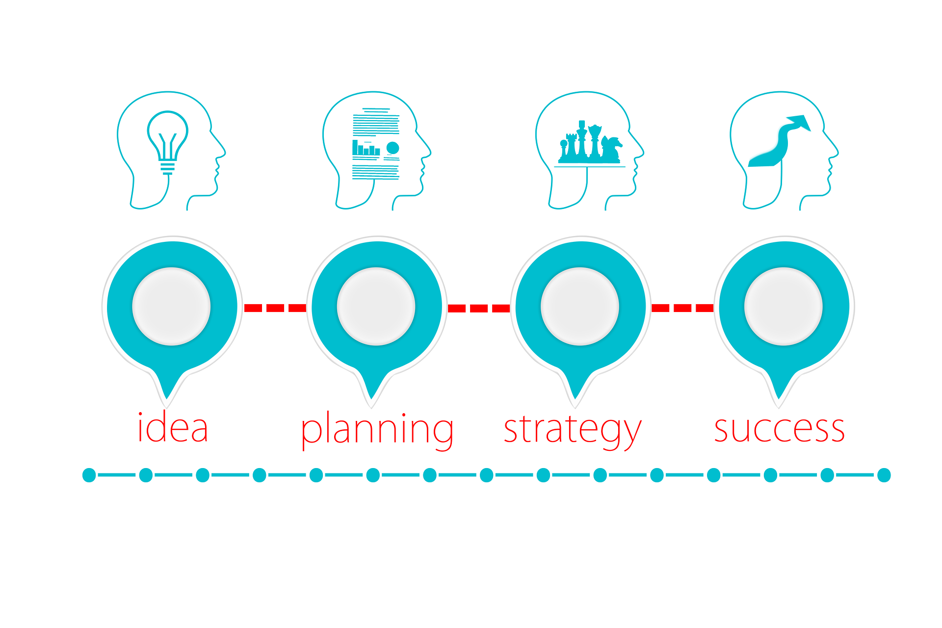
CLEAR METHODOLOGY
Notes:
GUIDELINES FOR ERASMUS+ NAs
This relates to the sub-criterion for “proposed methodology is clear, adequate and feasible”. Under this slide, it is important to confirm that this element is not purely related to management of the project or partnership, with many applicants often addressing their explanations to this aspect along (e.g. plans to make use of Prince 2 project management approach). Instead, an overall vision for project delivery should be detailed, confirming the different stages of project and output delivery and highlighting specific dependencies. For inclusion projects, the types of processes and activities that will be employed to facilitate the participation of persons with fewer opportunities should be clearly detailed. For those operating in the Youth sector, non-formal and informal learning methods should be outlined as a means of stimulating creativity, active participation and initiative among ultimate beneficiary audiences.

Slide 6

Complete and Credible Workplan
Notes:
GUIDELINES FOR ERASMUS+ NAs
This relates to the sub-criterion for “project work plan is clear, complete and effective, including appropriate phases for preparation, implementation and sharing project results.”. In this slide, it is important to remind assessors of the recent return to workplans and of the need for individual work packages to confirm exactly what is planned for delivery, when and with what purpose. Partner and beneficiary engagement should also be detailed in individual work packages, as should tasks, outputs and expected costs. In all cases, it is recommended that a workplan comprises a maximum of 5 individual work packages but there are no rules to say that 4 work packages or 6 work packages cannot be accepted, where convincingly justified by the applicant. Assessors should focus on the bigger picture, confirming clarity, comprehensiveness and achievability, as well as judging the level and quality of detail provided in individual work packages. Assessors should also be reminded of the importance of moving away from previous definitions of activities and financing (e.g. management meetings would be expected to appear in the work package for project management, but it is not impossible for other meeting and event types to appear elsewhere in the workplan; no requirement for dissemination activities to be solely embedded in the work package for project management).

Slide 7

appropriate evaluation and monitoring activities at critical stages of the project
Notes:
GUIDELINES FOR ERASMUS+ NAs
This relates to the sub-criterion for “project proposes appropriate quality control, monitoring and evaluation measures to ensure that project implementation is of high quality, completed in time and on budget”. It is important for assessors to confirm that this aspect of the project is sufficiently addressed through activities that are clear in terms of what they intend to achieve (e.g. determining the quality of outputs; soliciting feedback on the adequacy and usability of key products and services; gauging the satisfaction of partners and beneficiaries on their experience in the project), how and when they will be delivered and who will be involved in their delivery, ensuring that those that are tasked with these tasks have the necessary experience and expertise. It is also important to have quality assurance activities timed at a point where they might help to improve the quality of one or more activities or outputs.

Slide 8

Accessible and Inclusive Design
Notes:
GUIDELINES FOR ERASMUS+ NAs
This relates to the sub-criterion for “activities are designed in an accessible and inclusive way and are open to people with fewer opportunities”. The idea of this slide is to underline the importance of detail on how access and inclusion is to be facilitated or achieved, going beyond a simple commitment and outlining specific efforts or actions that will be undertaken with a view to identifying and addressing barriers for participants considered to have specific or additional needs (participants with fewer opportunities).

Slide 9

Digital Tools and Methods
Notes:
GUIDELINES FOR ERASMUS+ NAs
This relates to the sub-criterion for “project incorporates the use of digital tools and learning methods to complement physical activities and improve the cooperation between partner organisations”. Here it is important to acknowledge the dual aspect of digital transformation in Erasmus+ Small Scale Partnerships and Cooperation Partnerships. On the one hand, digital transformation might form part of the overall project aim or development goals (e.g. capacity-building for staff; better integrating digital technologies into teaching and learning). On the other hand, there might be aspects of the project which rely on the use of digital tools, platforms and technologies and the proposal should provide the necessary insight into the targeted digital platforms and tools as well as providing full justification for their selection, continued development (where needed) and use. Assessors should also acknowledge plans for the use of Erasmus+ digital platforms, such as eTwinning and School Education Gateway (SCH), EPALE (ADU and VET) and the European Youth Portal (YOU) in project delivery.

Slide 10

Green Practices
Notes:
GUIDELINES FOR ERASMUS+ NAs
This relates to the sub-criterion for “project is designed in an eco-friendly way and incorporates green practices in different project phases”. There are two elements that assessors need to consider under the heading of green transition. On the one hand, assessors should recognize and reward efforts to raise awareness on the challenges of environmental and climate change which could be a direct feature of the project or part of the wider development goals (e.g. educating others on the importance of reducing energy use and waste or opting for sustainable food and mobility choices). On the other hand, it is important to acknowledge and reward projects that make specific efforts to embed green practices in one or more aspects of project and output delivery (e.g. printing materials only in exceptional cases; promoting green travel options).

Slide 11

Teaching, Training and Learning Activities
APPROPRIATE
HIGH-QUALITY
RECOGNISED
Notes:
GUIDELINES FOR ERASMUS+ NAs
This relates solely to projects that plan to embed TEACHING, TRAINING AND LEARNING ACTIVITIES into their project design. This is a concept that comes forward from the previous unit cost financing model yet is now more open and flexible in terms of the types of activity being delivered and the types of participants engaged, with no specific rules or limitations applied. What is important for assessors to consider is the VALUE AND CONTRIBUTION of the targeted activities to overall project and output delivery, the QUALITY OF SELECTION, PREPARATION, SAFETY AND SUPPORT ACTIONS, and ADEQUACY OF MEASURES THAT WILL BE USED FOR RECOGNISING AND VALIDATING LEARNING OUTCOMES, for which specific tools and processes are suggested for each of the different fields (e.g. ECTS, Europass, Youthpass).

Slide 12

What’s Missing?
Notes:
GUIDELINES FOR ERASMUS+ NAs
Thos paying attention will have noticed that only 8 elements have been introduced and it can be fun to ask participants what is the missing element.

Slide 13

Lump Sum Financing
Notes:
GUIDELINES FOR ERASMUS+ NAs
This relates to the sub-criterion for “project is cost-effective and allocates appropriate resources to each activity”. It is important to recognise that lump sum financing is still relatively new and that assessors are often unsure about what their role is and how they might determine cost-effectiveness and value-for-money. At this point, it is worth highlighting that the remainder of this session will be focused on this new approach, including an opportunity to experience the life of the applicant when preparing a budget.

Slide 14

Notes:
GUIDELINES FOR ERASMUS+ NAs
At this point, there is an opportunity to play a short video on Lump Sum financing in Erasmus+ and Key Action 2, which can be accessed at: https://youtu.be/W955IsKMpFI.
Where possible, try to play the video in full prior to the start of the event, this can help in the speed of playback due to accessing cache memory.
© Orientra (2018)

Slide 15
A few more slides !
Notes:
GUIDELINES FOR ERASMUS+ NAs
This follows the concept of keeping things simple and promoting the use of active and peer learning approaches during the training session. This is an additional set of slides which fits under the broader heading of QUALITY OF PROJECT DESIGN but which focuses specifically on lump sum financing and value-for-money and for which messages are generally shorter and more practical.

Slide 16

Financial Wizards Not Needed
Notes:
GUIDELINES FOR ERASMUS+ NAs
Here there is a simple message to relay, in that assessors do not need to be financial wizards that will undertake complex calculations. The focus for assessors is always on confirming cost effectiveness and value-for-money using the detail provided in the proposal.

Slide 17

Economy = Spending Less
Efficiency = Spending Well
Effectiveness = Spending Wisely
Guided by
the Proposal
Notes:
GUIDELINES FOR ERASMUS+ NAs
Here it can be useful to explain what is mean by ECONOMY (careful management of resources, savings or spending less), EFFICIENCY (achieving goals and objectives through the efficient use of human, technological and financial resources with little or no waste or spending well) and EFFECTIVENESS (ensuring accountability, transparency and financial responsibility or spending wisely) and to reiterate the fact that decisions are made according to the descriptions provided in the proposal.

Slide 18

First Impressions
Can Differ
Economies and Lifestyles Play
an Important Part
Notes:
GUIDELINES FOR ERASMUS+ NAs
Here there is a chance to engage with participants, to ask them to confirm what the price would be for the basket of fruit, including the basket and all elements.
In multi-country or multi-city events, prices might differ and you should try to relate this to the differing economies, or different lifestyles that people have, with some opting for ‘pile it high’ supermarkets and others preferring organic produce or farm shops. If all are reporting the same price, acknowledge this but ask them to consider what the answer might be in countries with notably different economies (e.g. significantly higher costs; significantly lower costs). Highlight the importance of acknowledging this when reflecting and considering this in budgets for a transnational project or partnership.

Slide 19
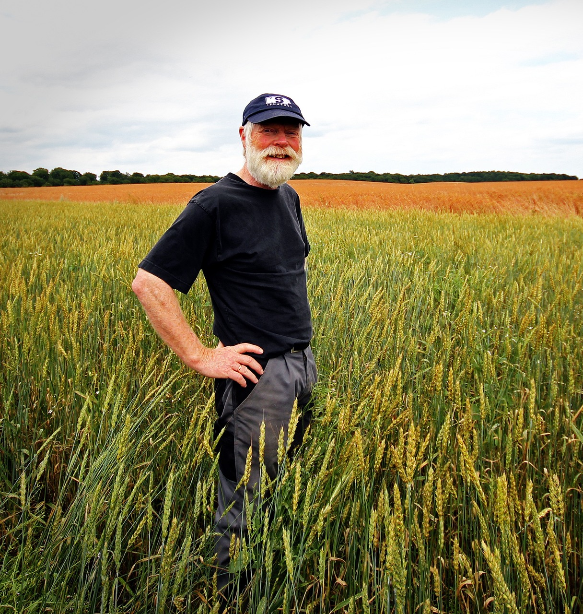
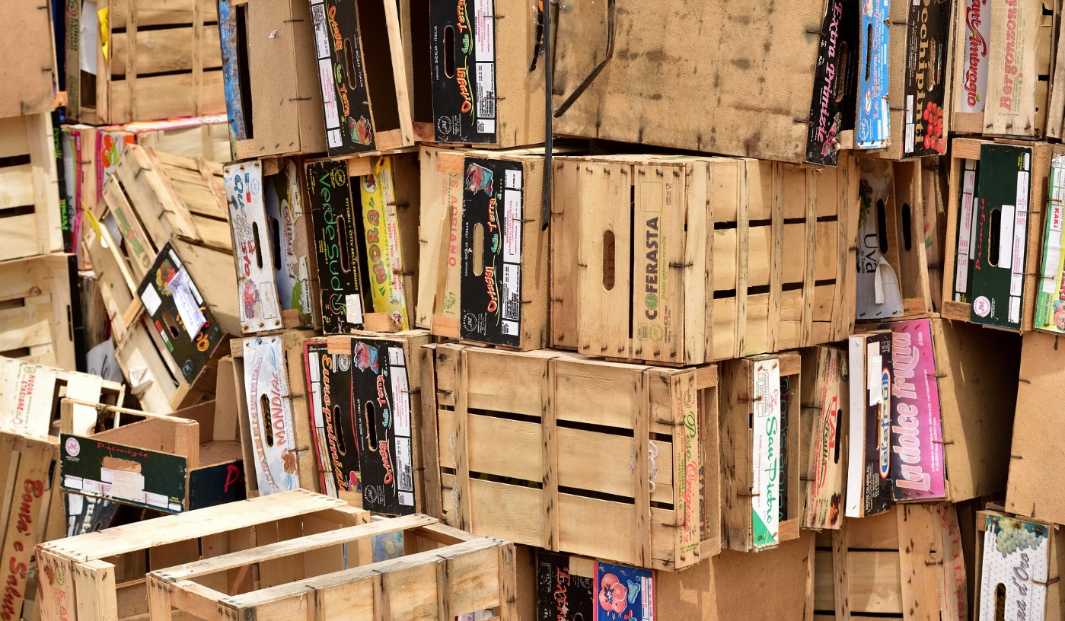

Perspectives
Differ
Important to Drill Down
Notes:
GUIDELINES FOR ERASMUS+ NAs
Here you should highlight that perspectives on VALUE can differ according to the time and effort being invested.
Use the example of the farmer who spends a lot of time planting, nurturing and harvesting fruit, compared to the wholesaler who has the product for a limited amount of time before handing to the retailer, compared to the consumer who pays only for what they see on the day of purchase.
Underline the importance of recognising the steps and processes involved in delivering a product. Talk of the importance of drilling down an activity to its compositive tasks. Remind assessors, once again, of the need for the applicant to provide this level of insight and detail in the workplan.

Slide 20

Targets and Indicators
Notes:
GUIDELINES FOR ERASMUS+ NAs
Here it can be useful to inform assessors of the increased importance of targets and indicators, both as a means of determining the size, scale, magnitude and outreach of a particular task or activity but also in terms of using indicators to determine when something has been successfully completed or achieved (advise assessors that indicators will also play an important part at the project end).

Slide 21

KA220 Assessment Criteria: Project Design
Extent to which…
Project OBJECTIVES are clearly defined, realistic and address the needs and goals of the participating organisations and the needs of their target groups.
Proposed METHODOLOGY is clear, adequate and feasible.
Project WORKPLAN is clear, complete and effective, including appropriate phases for preparation, implementation and sharing project results.
Project is COST-EFFECTIVE and allocates appropriate resources to each activity.
Project proposes appropriate QUALITY CONTROL, MONITORING AND EVALUATION measures to ensure that the project implementation is of high quality, completed in time and on budget.
Activities are designed in an ACCESSIBLE AND INCLUSIVE way and are open to people with fewer opportunities.
Project incorporates the use of DIGITAL TOOLS AND LEARNING METHODS to complement physical activities and improve the cooperation between partner organisations.
The project is designed in an eco-friendly way and incorporates GREEN PRACTICES in different project phases.
WHERE RELEVANT: TEACHING, TRAINING OR LEARNING ACTIVITIES are appropriate and involve the appropriate profile and number of participants: plus quality of practical arrangements, management and support modalities and quality of arrangements for recognition and validation of learning outcomes
Notes:
GUIDELINES FOR ERASMUS+ NAs
This overview slide confirms those aspects which relate to KA220 (all listed elements) and those which relate to KA210 (labelled as SSP). It provides an opportunity to underline ambitions for engaging newcomers in KA210 and the need for proportional assessment.

Slide 22

ACTIVITY 3: PROJECT DESIGN
Mixed-field Groupwork
Notes:
GUIDELINES FOR ERASMUS+ NAs
Section Title Page: it can be useful to have a space to breathe between the different sections (and sub-sections) of the training.

Slide 23

Mixed-field Groups
Notes:
GUIDELINES FOR ERASMUS+ NAs
Unlike previous activities where field-based working was encouraged, there is value in having participants work in multi-field groups where they can share experiences during the groupwork.
There are lots of options for dividing participants into groups but the simplest method is to decide how many groups you would like and, starting at the front of the room, ask participants to call out numbers in order up to the agreed number of groups. For example, if you need 5 groups, ask participants to call out 1 then 2 then 3 then 4 then 5 (in that order) before starting the count again at 1. Numbers are called out, from 1 to 5, until all participants have a number. This number determines that group that they are in for this session.

Slide 24


MIXED-FIELD GROUPWORK
Appoint Rapporteurs
Complete Workplan and Budget
Sub-divide
ALL Groups
Design Single Work Package and Budget
Group Recap and Review
180
Notes:
GUIDELINES FOR ERASMUS+ NAs
After the plenary introduction, the next step is for participants to work in groups to [a] design a single work package and budget and [b] complete the whole workplan and budget. In most cases, there will only be time for part [a] to be completed, but templates and instructions are provided for both aspects. During previous training events, participants found the exercise difficult but useful as a means of better understanding the budget development process and, through this, being better able to understand the results.
STEP 1 allows for larger groups to be sub-divided to facilitate discussion. STEP 2 requires that a rapporteur be appointed for feedback in plenary. STEPS 3 and 4 require collaborative working on the design of one or more work packages and budgets. STEP 5 provides an opportunity for recap and review prior to feedback in plenary. The decision on whether or not to compare results across sub-groups will depend on the time available. In all cases, the timeclock should be updated to reflect your own schedule. Note: whilst an excel table is provided (see instructions), it is important to remind assessors that this exists solely for this training exercise and that applicants are not expected to present their data in Excel form.

Slide 25
ACTIVITY 3: PROJECT DESIGN
Plenary
Exchange
Notes:
GUIDELINES FOR ERASMUS+ NAs
Section Title Page: it can be useful to have a space to breathe between the different sections (and sub-sections) of the training.

Slide 26

Plenary Exchange
1. Did you complete ALL tasks?
2. What were the values for WP3 (days and costs) and the total lump sum value?
3. Were there any difficulties?
RAPPORTEUR FEEDBACK
➔ How does this address some of the remaining aspects for Project Design?
3
Notes:
GUIDELINES FOR ERASMUS+ NAs
This is a simple prompt for the plenary feedback session, providing a small number of questions against which the different groups (and sub-groups) will be invited to comment. Depending on the number of groups, and the time available, the time given to each rapporteur might need to be changed (usually 3 to 5 minutes per rapporteur).

Slide 27
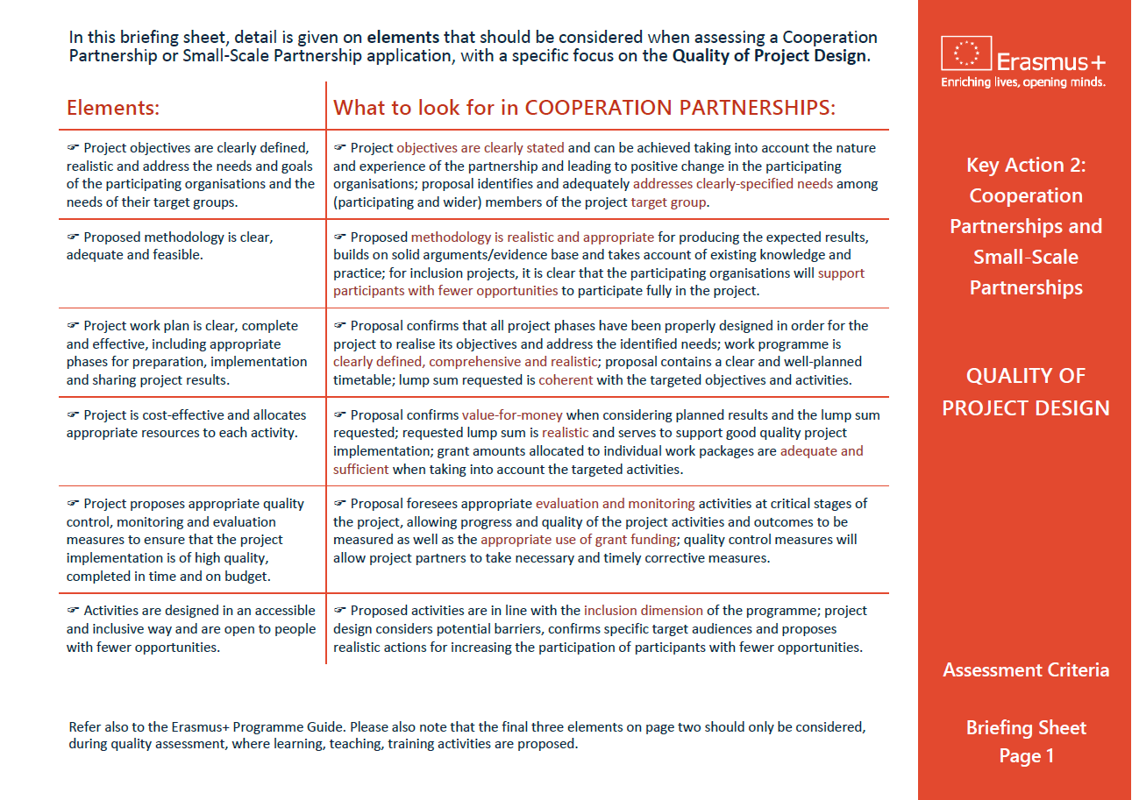
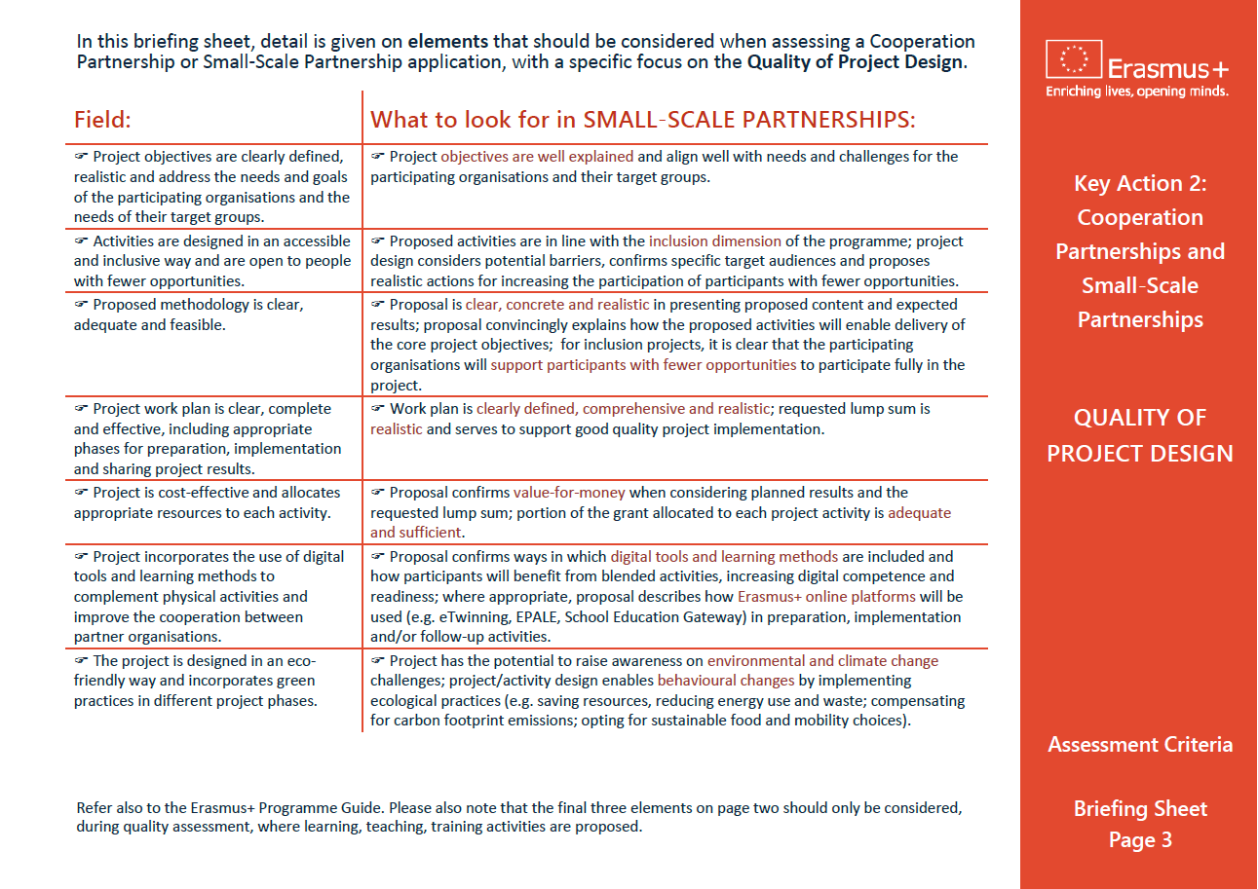
Quality of Project Design Briefing Sheet
Notes:
GUIDELINES FOR ERASMUS+ NAs
In this final slide, it can be useful to remind assessors of the availability of a written briefing sheet which confirms the key elements being judged under “QUALITY OF PROJECT DESIGN”.

