Slide 1




Collaboration on the Levelling-up of Erasmus+ Assessors through developing and testing a common Resource set for KA2 Assessment
Erasmus+ Assessor Training Workshop 2023
add location | add date
Notes:
GUIDELINES FOR ERASMUS+ NAs
This is the welcome screen. Add your own location and date.
You can also add your own logos but please retain the CLEAR and Erasmus+ logos.

Slide 2

Welcome and Introduction
Notes:
GUIDELINES FOR ERASMUS+ NAs
Section Title Page: it can be useful to have a space to breathe between the different sections of the training.

Slide 3
12
4
3
One CLEAR Vision
E+
€€€
KA2
33
2
140+
Notes:
GUIDELINES FOR ERASMUS+ NAs
Single slide introduction to the CLEAR LTA using numbers (see definitions below). Feel free to change some of the numbers to underline important elements of your own event:
12 = NAs involved in the CLEAR LTA.
4 = Fields being addressed by the CLEAR LTA (ADU, HED, SCH and VET).
3 = Years of Activity for the CLEAR LTA.
E+ = programme financing and benefitting from CLEAR LTA Activity.
KA2 = focus of CLEAR LTA assessor training activities - specifically KA210 and KA220 which follow the indirect management approach.
€€€ = move to lump sum financing which underpins to targeted training for Erasmus+ KA2 assessors.
33 = number of countries invited to participate in initial training events in Ljubljana and Rotterdam in Spring 2023.
2 = number of training events held in Spring 2023.
140+ = number of assessors and NA staff originally targeted for participation in the 2 training events in Spring 2023 (final numbers were closer to 100).

Slide 4
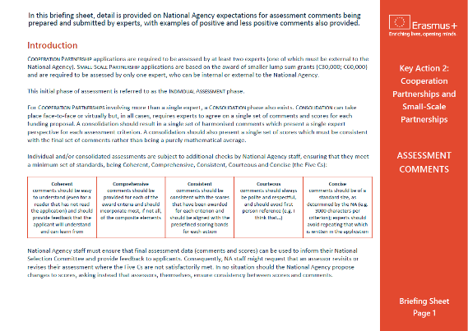
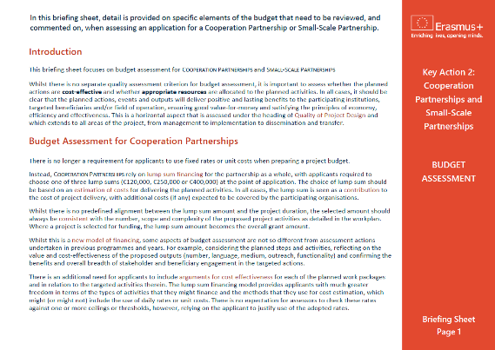

Additional Materials
Briefing Sheets
and Short Video
Notes:
GUIDELINES FOR ERASMUS+ NAs
A useful slide that allows you to mention that written Briefing Sheets also exist as well as a short animated video. Normally, the video is played as a part of the training session on Quality of Project Design. If you are not going to circulate these materials then you can remove this slide.

Slide 5

Learning Outcomes
Notes:
GUIDELINES FOR ERASMUS+ NAs
Important to use Learning Outcomes to encapsulate the targeted learning. These can be introduced as a whole set at the start of the training day, or used individually at the start of each training session.

Slide 6

By the end of this workshop, you will be able to:
1. DEMONSTRATE improved understanding of the key factors involved in determining the relevance of a KA220 (or KA210) funding proposal and APPLY this in your future assessments.
2. ASSESS the composition and quality of partnerships, REFLECT on their relevance to the selected field, to the targeted audiences and to the planned actions and outputs.
3. APPRAISE budgets and DETERMINE value-for-money,
using the data provided in proposals and workplans.
Notes:
GUIDELINES FOR ERASMUS+ NAs
Learning Outcomes 1-3: remember to adapt these to reflect those aspects of the training that you will use with your assessors.

Slide 7
By the end of this workshop, you will be able to:
4. DEMONSTRATE understanding of the key factors involved in determining quality of project design
5. EVALUATE impact potential, DISTINGUISH between quantitative and qualitative indicators and DELIVER an informed opinion on the adequacy and sufficiency of indicators/measures/targets.
6. EVALUATE the validity of measures within KA210 and KA220 proposals, aimed at promotion and continued use of the
developed concepts, products and services.
Notes:
GUIDELINES FOR ERASMUS+ NAs
Learning Outcomes 4-6: remember to adapt these to reflect those aspects of the training that you will use with your assessors.

Slide 8

More than Just Reading
Notes:
GUIDELINES FOR ERASMUS+ NAs
Important to remind participants that this (physical or virtual) training event requires active participation, to ensure added-value from a simple review of documents.

Slide 9

Programme and Timing
Notes:
GUIDELINES FOR ERASMUS+ NAs
Section Title Page: it can be useful to have a space to breathe between the different sections of the training.

Slide 10
MONDAY 6 MARCH 2023
15:00 Welcome and Introduction
15:15 Icebreaker and Group Formation
15:30 Erasmus+ Quiz
15:50 Activity 1 - Quality of Partnership
16:00 Assessment Scores
18:15 Close of Day One
19:15 COMMON DINNER (SS Rotterdam)
TUESDAY 7 MARCH 2023
09:00 WELCOME BACK AND ENERGISER
09:15 Activity 2 - Relevance
10:30 COFFEE BREAK
11:00 Activity 2 - Relevance (continued)
12:00 LUNCH BREAK
13:15 Activity 3 - Quality of Project Design
15:30 COFFEE BREAK
16:00 Activity 3 - Quality of Project Design (continued)
17:00 Assessment Comments
17:30 Close of Day Two
18:45 Walk to Nhow Rotterdam
19:30 COMMON DINNER (Nhow Rotterdam Restaurant)
Notes:
GUIDELINES FOR ERASMUS+ NAs
Event Programme Part 1: slide for presenting an outline programme and schedule (example based on Days 1 and 2 of the Rotterdam Assessor Training Event). Important to update this with your own training programme.

Slide 11



WEDNESDAY 8 MARCH 2023
09:00 WELCOME BACK, ENERGISER AND OVERVIEW
09:15 Activity 4 - Impact
10:30 COFFEE BREAK
11:00 Activity 4 - Impact (continued)
12:00 Consolidation Process
12:30 CLOSE OF EVENT, LUNCH AND DEPARTURE
Notes:
GUIDELINES FOR ERASMUS+ NAs
Event Programme Part 2: slide for presenting an outline programme and schedule (example based on Day 3 of the Rotterdam Assessor Training Event). Important to update this with your own training programme.

Slide 12

Icebreaker Session
Notes:
GUIDELINES FOR ERASMUS+ NAs
Section Title Page: it can be useful to have a space to breathe between the different sections of the training.

Slide 13

Erasmus+ Assessor Experience
Notes:
GUIDELINES FOR ERASMUS+ NAs
Icebreaker Example 1: this is suitable for a physical event where participants are asked to form a snake ranging from the HIGHEST number of years or assessment (head of the snake) to the LOWEST numbers of years of assessment (tail of the snake); this exercise requires a fairly large space but it is also easy to work around tables and chairs as you only need a single line/snake to be formed; this is a good exercise for highlighting the range of experience present in the room but it is also important to highlight that everybody has a role to play, irrespective of the number of years (or months) of experience.

Slide 14
Winter Slopes
(Ski)
Summer Sun
(Beach)
Exercise and Adventure
Something Else
Ideal Holiday
Notes:
GUIDELINES FOR ERASMUS+ NAs
Icebreaker Example 2: simple exercise where participants are invited to indicate their presence; in a physical event, participants are invited to stand in a corner or next to a written sign which shows their preference; in a virtual event, participants might vote as a way of showing their preference; in all cases, this is a fun way of showing diversity among participants.

Slide 15
Mediterranean
(Pasta, Pizza, Salad, Grill)
Meat Meat
Meat
Veggie Paradise
Something Else
Ideal Meal
Notes:
GUIDELINES FOR ERASMUS+ NAs
Icebreaker Example 3: alternative version of Icebreaker Example 2 (different topic). Sometimes, it can be fun to have multiple icebreaker questions to get people energised and engaged.

Slide 16



Something Else
Assessor Type
Notes:
GUIDELINES FOR ERASMUS+ NAs
Icebreaker Example 4: this exercise is similar to Icebreaker Examples 2 and 3 but with a focus on assessment types, where the WHALE is seen as empathic being able to share and understand the feelings of others, the ELEPHANT recognises their role in the herd being part of something that contributes to the common good and the LION is fierce and protective (i.e. looking for faults in proposals and protecting European funds). Again., a fun icebreaker but one which focuses on showing diversity among assessors. Often participants will chose SOMETHING ELSE when they do not feel comfortable with any of the other descriptions (e.g. part lion, part whale).

Slide 17

One More Question!
Notes:
GUIDELINES FOR ERASMUS+ NAs
Bridging Page: helps to move on to the next question.

Slide 18
ADU
HED
SCH
VET
Erasmus+ Fields
Notes:
GUIDELINES FOR ERASMUS+ NAs
Following on from the icebreakers, and whilst participants are still standing (mostly relevant to physical events), it can be useful to group participants under the different fields of education and training, which can be the basis for the next exercise: Group Quiz.

Slide 19

Group
Quiz
A Few Minutes to Say Hello
One Digital Entry per Table
Notes:
GUIDELINES FOR ERASMUS+ NAs
A Group Quiz achieves two goals simultaneously. Firstly, it is a chance for field-specific teams to work together, which is something that they will do during other parts of the training. Secondly, it is a chance to confirm existing knowledge levels on some of the basic aspects of the Erasmus+ programme (i.e. a quick instead of a short presentation).
Digital platforms or smartphone applications can be a fun way of engaging participants in a short quiz. Many platforms and applications exist so it is important to select one that you are comfortable with and know how to use. You might also have to check what licenses you have in your own organisation as free platforms or application often impose limits on the number of questions or the number of respondents. In all cases, a single response should be able to be submitted by each GROUP or TEAM. A QR code can also make it easier to access a digital platform or application.

Slide 20



Site: add URL
Session ID: add code or QR
Notes:
GUIDELINES FOR ERASMUS+ NAs
In the quiz used in Rotterdam, a series of 10 multiple choice questions were used, namely:
1. Erasmus+ allows for different levels of participation among "EU Countries and those Associated to the Programme" and "Countries Not Associated to the Programme". Looking beyond the EU27, which are the SIX ASSOCIATED COUNTRIES?
2. For the programme period 2021-2027, which of the following represent the FOUR HORIZONTAL PRIORITIES of the Erasmus+ programme?
3. According to the 2023 Programme Guide, how many Funding Actions are Supported by KEY ACTION 2 of the Erasmus Programme?
4. For the Key Action 2 Partnerships for Cooperation (managed by Erasmus+ National Agencies) how many Call Deadlines might you expect to see each year?
5. For proposals under Cooperation Partnerships (KA220), which of these statements is correct?
6. When assessing project proposals under Key Action 2 Partnerships for Cooperation, what are the FOUR AWARD CRITERIA that are used?
7. Which of the following statements is correct in relation to the minimum score required for a Cooperation Partnership (KA220) to be considered for financing?
8. For Cooperation Partnerships (KA220) - the larger of the two partnership actions - which of the following are eligible lump sums?
9. What is maximum number of Work Packages that is allowed within a Cooperation Partnership (KA220)?
10. Which of these is the correct name for the digital platform that is used by experts to submit Erasmus+ KA210 and KA220 Assessments?
Different questions can be used in your own event, and you can choose which options to add for multiple choice questions.

